Slide 1
Azure IaaS Workshop for Azure Everywhere Series
Scott McFadden April 27th 2017

Slide 2
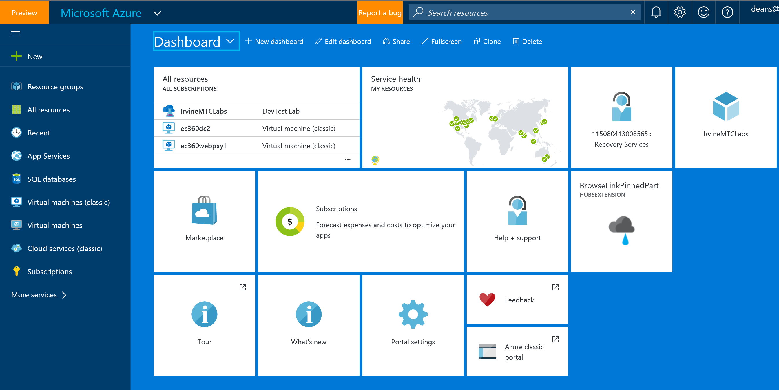
Welcome and Introductions
Please Introduce Yourself
Name,
Company,
Experience with Azure
What Would You Like to Get Out of Today?

Slide 3


Cloud Services
Packaged Software
Infrastructure
(as a Service)
Platform
(as a Service)
Software
(as a Service)
Applications
Applications
You manage
Applications
Applications
Data
You manage
Data
Data
Data
Runtime
Runtime
Runtime
Runtime
Managed by vendor
You manage
Middleware
Middleware
Middleware
Middleware
Managed by vendor
O/S
O/S
O/S
O/S
Virtualization
Virtualization
Managed by vendor
Virtualization
Virtualization
Servers
Servers
Servers
Servers
Storage
Storage
Storage
Storage
Networking
Networking
Networking
Networking

Slide 4
Evaluate workload patterns
“On and Off “
“Growing Fast“
Inactivity
Period
Compute
Compute
Average
Usage
Average Usage
Time
Time
“Unpredictable Bursting“
“Predictable Bursting“
Compute
Compute
Average Usage
Average Usage
Time
Time
Notes:
If you want to keep this, move to slide 2 or 3
Key Points:
Irregular and extreme workload patterns are ideal candidates for movement to the cloud
Irregular patterns represent potentially low utilisation of expensive capital
Extreme workloads can be a “worst case” scenario for a business that’s unable to address the demand from a successful product launch.
Script:
These diagrams provide an interesting sieve against which to categorize applications:
On and Off: Similar to Predictable Bursting, On and Off can have seasonal or time-bounded workloads where there are all or almost nothing processing requirements. Important enterprise workloads including those that are run monthly, quarterly and annually exhibit this type of behavior.
Unpredictable Bursting: Something happens that triggers heavy usage requirements so normally you would have had to scale design considerations to try and ‘predict’ what this requirement ‘could be’. This may be one of the worst cases for which to plan: consider an emergency response system for which normal operation is fairly well understood, but then a hurricane hits and just when you most need the system, it gets overwhelmed.
Predictable Bursting: Think Dominos…on Friday Nights or Super bowl Sunday. Most of the year or days of the week, demand is much less. Even though the additional load is expected, it is expensive to maintain this capacity because it is under-utilized when demand is lower.
Growing Fast: This is interesting in the case of smaller startup companies or groups in larger companies and/or can be associated with new development. How to plan, both during development and operation. Elasticity can be a huge opportunity/savings area.

Slide 5
Momentum
120,000
New Azure customer subscriptions/month
150 billion
Azure SQL query requests processed/day
>85%
of Fortune 500 use Microsoft Cloud
715 million
Azure Active Directory users
120 billion
Hits to websites run on Azure Web App Service
Notes:
We’ve had incredible momentum in the last year with over 85% of Fortune 500 companies using the Microsoft Cloud.

Slide 6


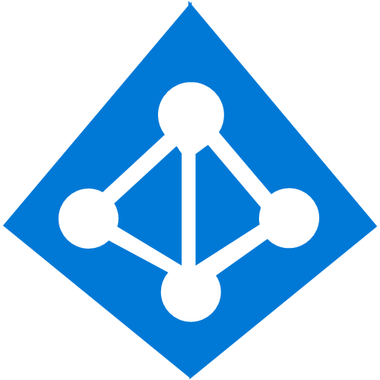










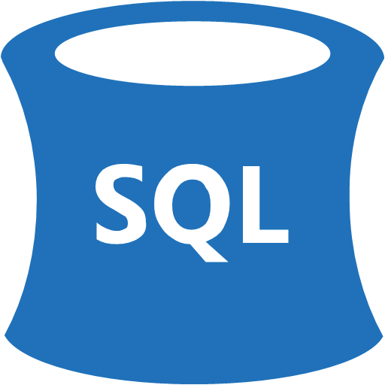



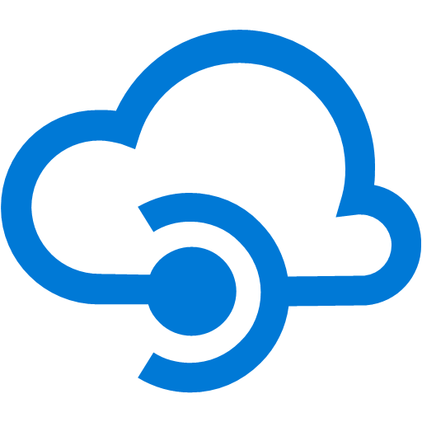
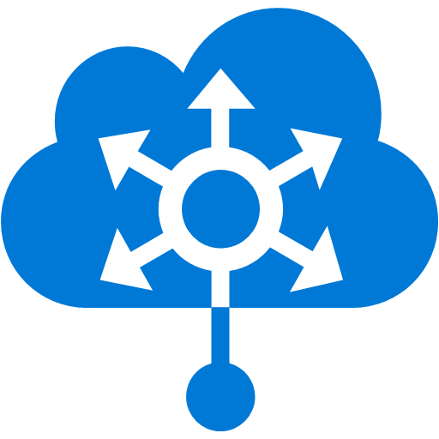















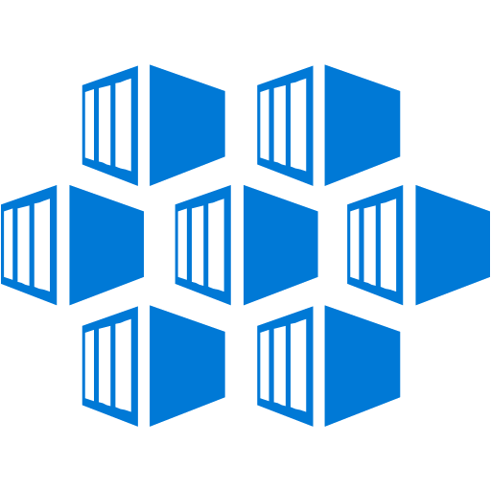







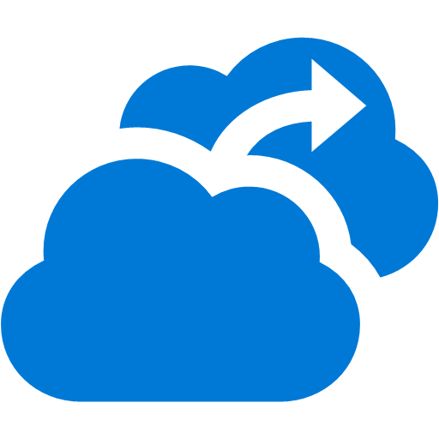






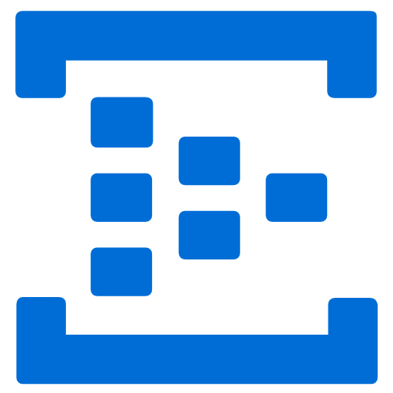














Platform Services
Security & Management
Hybrid
Cloud
Media & CDN
Application Platform
Data
Security Center
Content Delivery
Network
SQL
Database
Azure AD
Health Monitoring
Media Services
Media Analytics
Web
Apps
Mobile
Apps
SQL Data
Warehouse
DocumentDB
Portal
AD Privileged
Identity
Management
Azure Active
Directory
Integration
API
Apps
Cloud
Services
SQL Server
Stretch Database
Redis
Cache
Storage
Tables
Azure
Search
Azure AD
B2C
API
Management
BizTalk
Services
Domain Services
Service
Fabric
Notification
Hubs
Intelligence
Multi-Factor
Authentication
Logic
Apps
Service Bus
Functions
Cognitive Services
Bot Framework
Cortana
Backup
Automation
Developer Services
Analytics & IoT
Operational
Analytics
Compute Services
Scheduler
HDInsight
Machine
Learning
Stream Analytics
Container
Service
VM
Scale Sets
Visual Studio
Mobile
Engagement
Import/Export
Key Vault
Data
Catalog
Data Lake
Analytics Service
Data Lake Store
Store/
Marketplace
Batch
RemoteApp
VS Team Services
Xamarin
Azure Site
Recovery
Application
Insights
HockeyApp
IoT Hub
Event
Hubs
Data
Factory
Power BI
Embedded
VM Image Gallery
& VM Depot
Dev/Test Lab
StorSimple
Infrastructure Services
Compute
Storage
Networking
Virtual Machines
Containers
Blob
Queues
Files
Disks
Virtual Network
Load Balancer
DNS
Express
Route
Traffic Manager
VPN Gateway
App
Gateway
Datacenter Infrastructure (38 Regions, 34 Online)
Notes:
Why this Slide:
It shows we have a very broad platform. It about BOTH IaaS and PaaS, that these work together. It shows that we continue to lead in world class IT capabilities and that there’s really nothing missing.
Key Points:
We have already seen how the Azure Platform is IaaS + Pass – but I want you to understand that this is a huge number of capabilities – IT building blocks if you will.
Every one of these blocks you provision anytime, self-service anywhere in the world 24x7. You pay for what you use, you can get more or less anytime and you can fully automate everything…
DON’T spent too much time on this slide – you are going to DEMO (aren’t you!!!)… DON’T go through each block…
Transition to NEXT Slide: Make the build go backwards to show JUST IaaS and then you will go to the demo to show it.

Slide 7
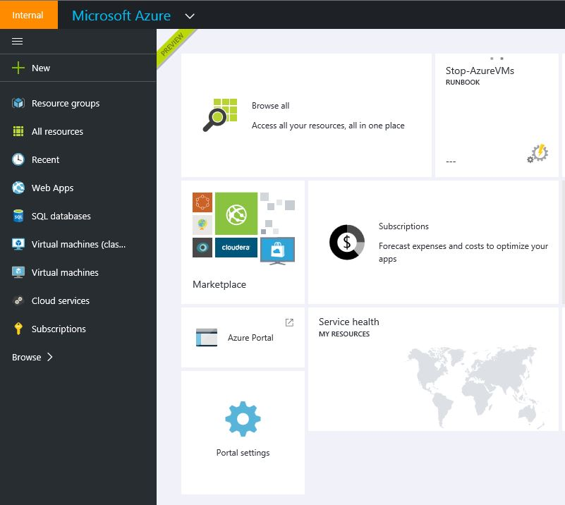
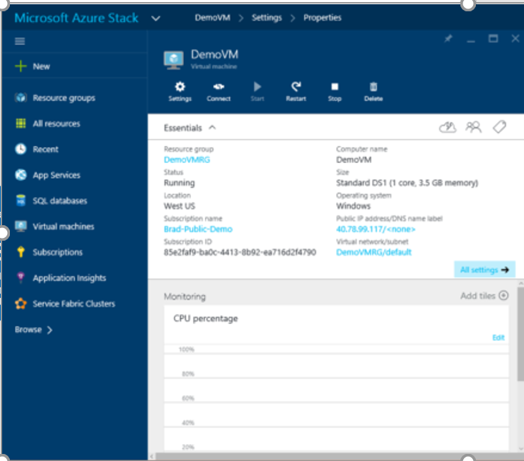
One consistent experience
Customer
ONE
Consistent Platform
Service Provider
Microsoft

Slide 8


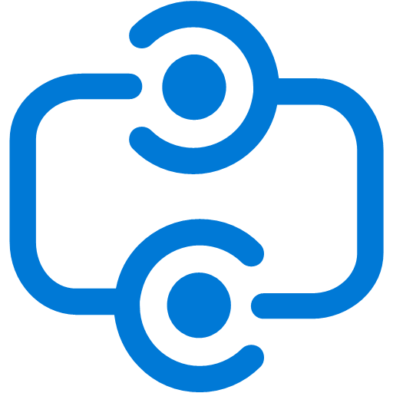
Azure Stack GA Target
Platform Services
Security and Management
Compute
Web and mobile
Developer services
Hybrid
Operations
Cloud Services
Service Fabric
Web Apps
API Apps
API Management
Visual Studio
Azure SDK
Portal
Azure AD Connect Health
Active Directory
Batch
Remote App
Mobile Apps
Logic Apps
Notification Hubs
Team Project
Application Insights
AD Privileged Identity Management
Multi-factor Authentication
Integration
Analytics and IoT
Data
Backup
Automation
Storage Queues
Biztalk Services
HDInsight
Machine Learning
SQL Database
SQL Data Warehouse
Operational Insights
Key Vault
Hybrid Connections
Service Bus
Data Factory
Event Hubs
Redis Cache
Search
Import/Export
Store/ Marketplace
Media and CDN
Site Recovery
Stream Analytics
Mobile Engagement
DocumentDB
Tables
StorSimple
VM Image Gallery and VM Depot
Media Services
Content Delivery Network (CDN)
Infrastructure Services
Compute
Storage
Networking
Virtual Machines
VM extensions (incl. Containers)
BLOB Storage
Azure Files
Premium Storage
Virtual Network
Load Balancer
DNS
Express
Route
Traffic Manager
VPN Gateway
Application Gateway
Legend
= In preview at Azure Stack GA
Notes:
Are there any updates to which Azure services will be in Azure Stack?
3 updates:
Logic apps will no longer be part of Azure Stack at initial GA release. We’re reassessing when that’s going to be possible
Containers – VM extensions (not Azure Container Service).
Premium Storage (pre-reqs SSDs, limited in Azure itself).

Slide 9

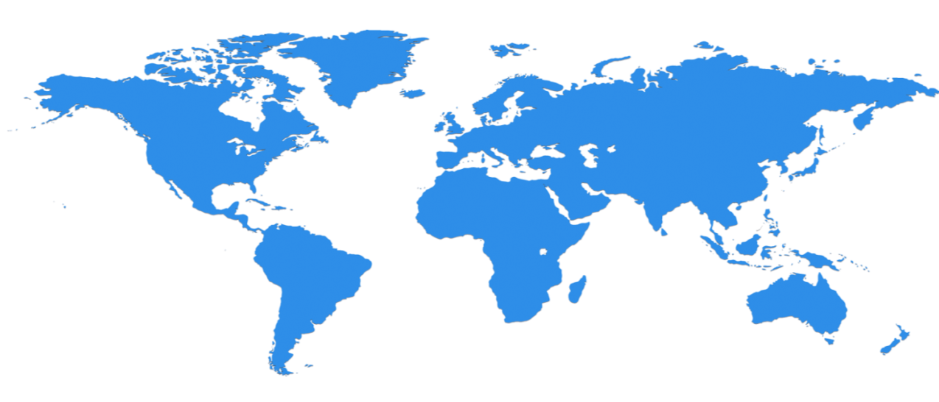

Hyper scale Infrastructure
34 Regions Worldwide, 26 ONLINE…huge capacity around the world…growing every year
North Central US
Illinois
United Kingdom
Regions
West Europe
Netherlands
Canada Central
Toronto
United Kingdom
Regions
Central US
Iowa
Canada East
Quebec City
Germany North East **
Magdeburg
US Gov
Iowa
China North *
Beijing
North Europe
Ireland
Germany Central **
Frankfurt
China South *
Shanghai
Japan East
Tokyo, Saitama
West US
California
East US
Virginia
India Central
Pune
Japan West
Osaka
South Central US
Texas
East US 2
Virginia
US Gov
Virginia
India South
Chennai
India West
Mumbai
East Asia
Hong Kong
SE Asia
Singapore
Australia East
New South Wales
Brazil South
Sao Paulo State
Australia South East
Victoria
100+ datacenters
Top 3 networks in the world
2.5x AWS, 7x Google DC Regions
G Series – Largest VM in World, 32 cores, 448GB Ram, SSD…
Operational
Announced/Not Operational
* Operated by 21Vianet ** Data Custodian - Deutsche Telekom
Notes:
Why this Slide:
This is SUCH a big investment – it’s a game for only very few. It’s not new for us – we have been doing this for our own services and our consumer/web properties for 20+ years
Key Points:
Where are we – EVERYWHERE…!
How big is this - $15+ B and counting – this is serious, we continue to bet big and you can count on us
Talk about DC innovation – DC Efficiency and Gen 5 data centers.
Scale – at this scale you do get efficiencies – the main one being POWER
Remember our “strategy” – we will be in the major places, but not everywhere – we have Azure Stack/Hosters for that.
The security controls we apply to development, infrastructure, operations, and compliance apply to our global customer base. Customers can explicitly choose which regions to deploy and store their data according to local privacy, security, or compliance requirements.
On this slide you can see the 34 regions where we operate (26 are active), including:
Public cloud regional datacenters with geographic diversity. Customers can deploy two identical workloads in different regions with an Active/Active failover model. This can ensure business continuity in the event of a local disaster.
Local and sovereign cloud. In-country Microsoft datacenters address data residency requirements, and we’re using a combination of technology as well as a legal framework to legally isolate certain regions of the world according to local sovereignty, governance, and rule of law, all the while providing the same exact up to date set of services in those regions.
There are four sovereign clouds today and four more planned, including Germany for example, as well as:
US Gov (2)
China North Beijing
China South Shanghai
Planned:
Germany Central
Germany Northeast
US DoD East
US DoD West

Slide 10
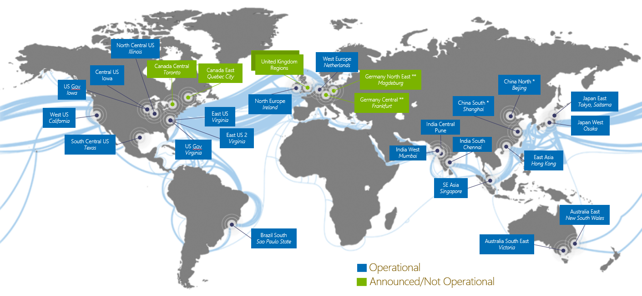
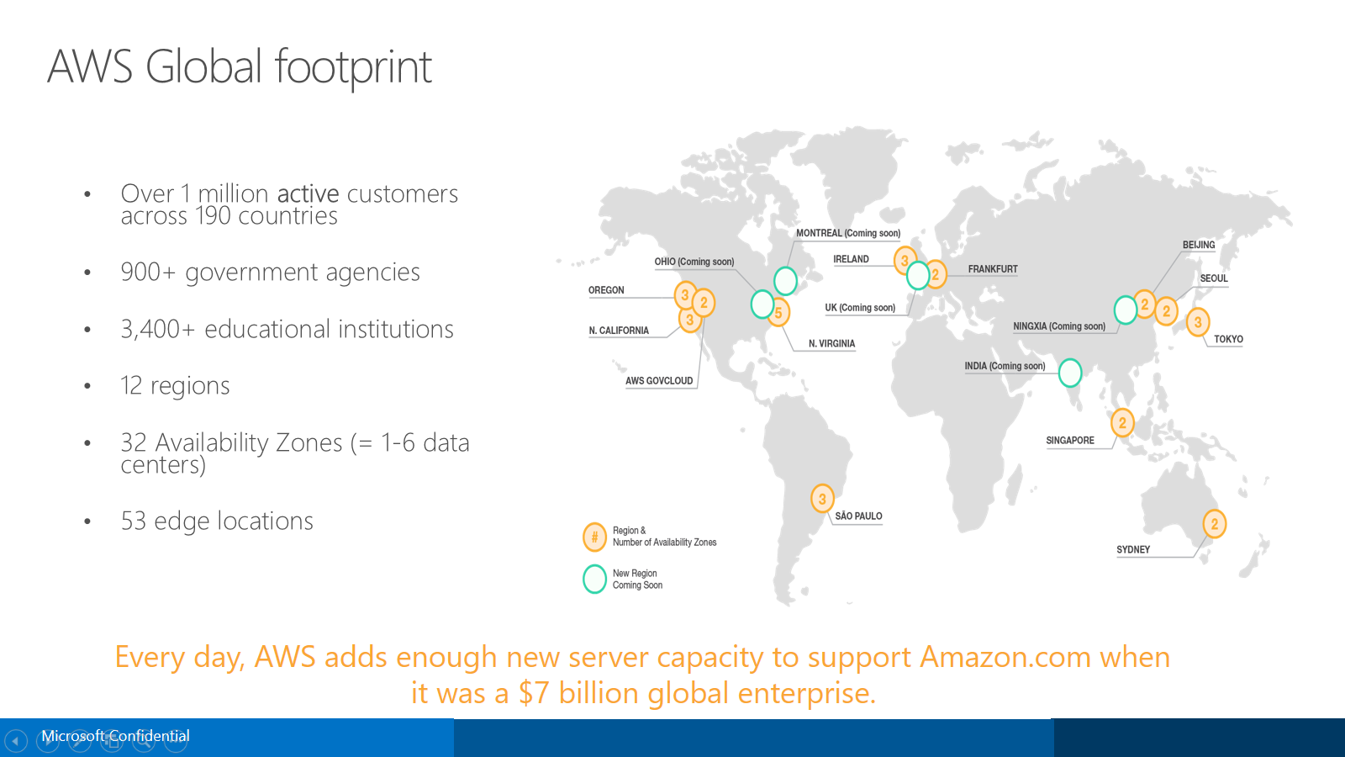
Azure and AWS Regions
Azure (34 regions, 26 online)
AWS (16 regions, 12 online)
Disaster proof Region Pairs in a geo-political area
No geo-political region pairs, regions are not disaster proof
A region is a massive mainly purpose built Data Center (DC)
A region is a collection of smaller owned and colo DC’s called Availability Zones (AZ’s) – 32 in total
DC’s have multiple layers of hardware and software redundancy for HA
AZ’s are well connected across flood plains and within a short car journey for HA
Region to Region traffic over Azure backbone
Region to Region traffic over public internet
You CAN visit an Azure DC..!
You CANNOT visit an AWS DC..?

Slide 11
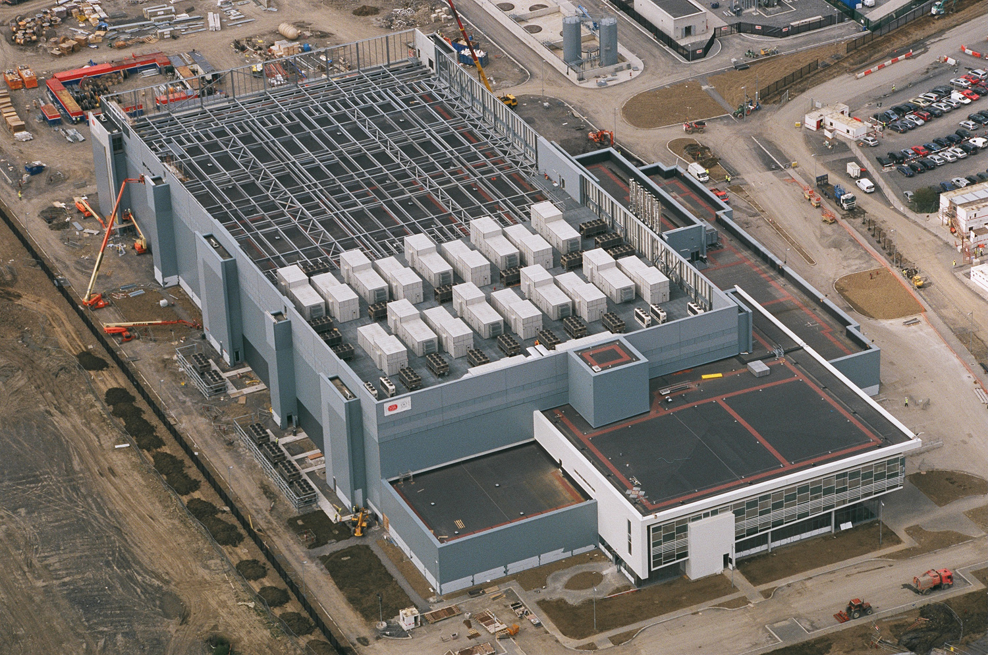
Oh my… 1 of 4 identical buildings per data center
Notes:
Azure data centers are huge! This is one of four buildings with each building capable of holding 2 747 nose to tail.

Slide 12
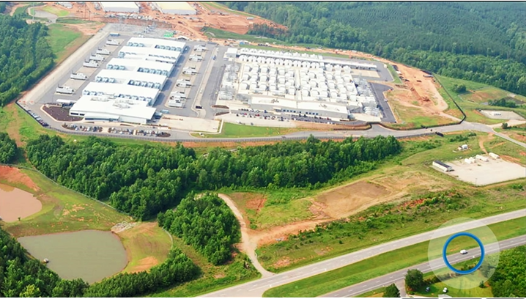

Slide 13
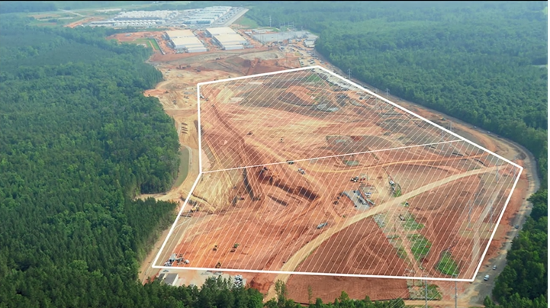

Slide 14
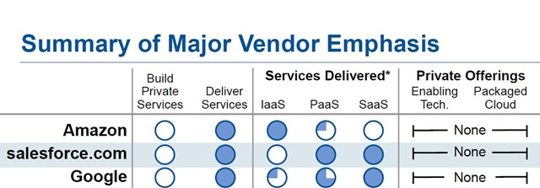
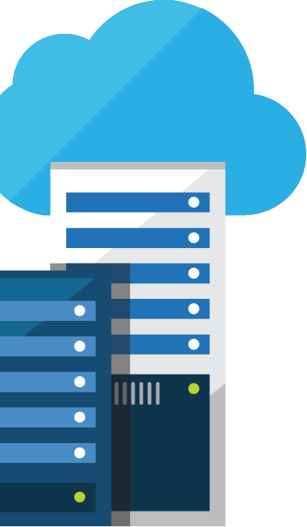
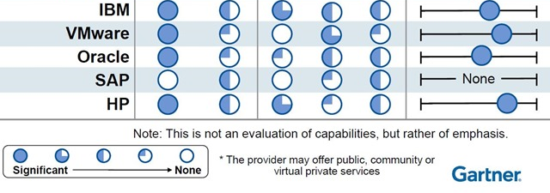
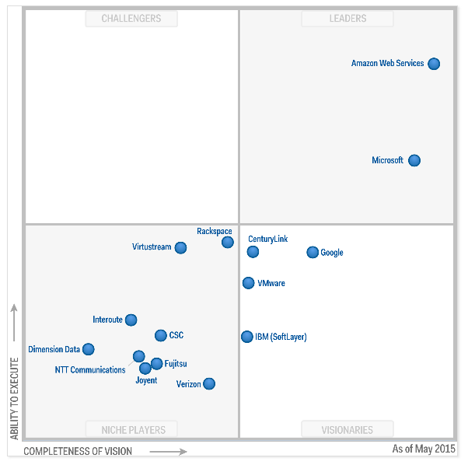
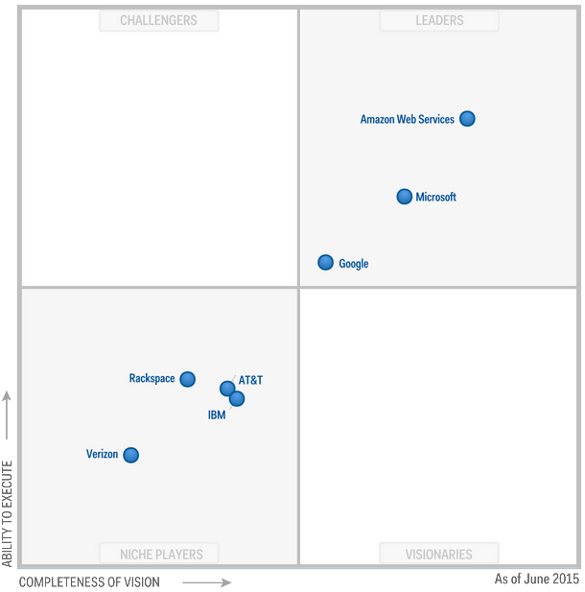
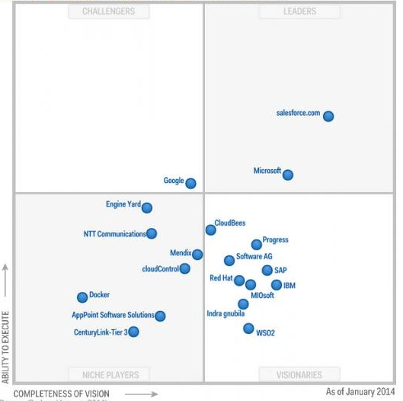
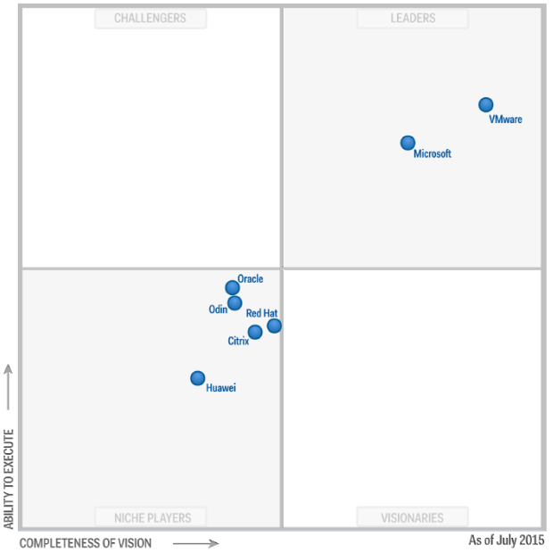
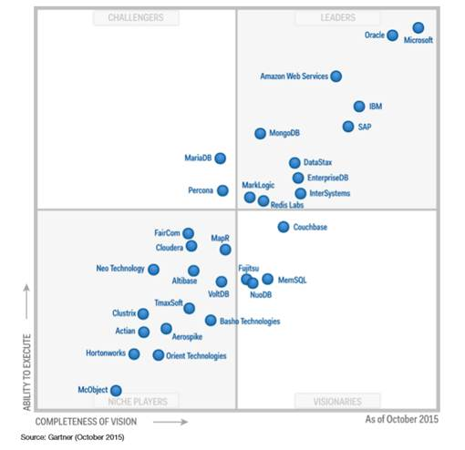
Industry validation
"Microsoft’s comprehensive hybrid story, which spans applications and platforms as well as infrastructure, is highly attractive to many companies, drawing them towards the cloud in general.”
LYDIA LEONG, Gartner
Microsoft leads everywhere …
Public Cloud IaaS (May 2015)
Cloud Storage (June 2015)
Enterprise App PaaS (Jan 2014)
X86 Server Virt (July 2015)
Operational DBMS Systems (Oct 2015)
Microsoft
Microsoft
Microsoft
Microsoft
Microsoft
Notes:
Why this Slide:
Extra weight to tell the story of our unique strategy – IMPORTANT – you are not selling a product or even a platform – you are really selling a long term vision – and you have to sell this high up.
Key Points:
Don’t go into any detail here, don’t get drawn into any specific MQ
MAIN POINT – MSFT continues to innovate – we are a true software and platform company and we have been doing this for 30 years (this is a dig at AWS mainly)
We are persistent – we strive but don’t always succeed to be the leader (be humble, but land that we have long term horizons, we will be there, we don’t back away from hard problems)
Transition to NEXT Slide: So let’s start understanding in more detail WHAT is Azure.

Slide 15

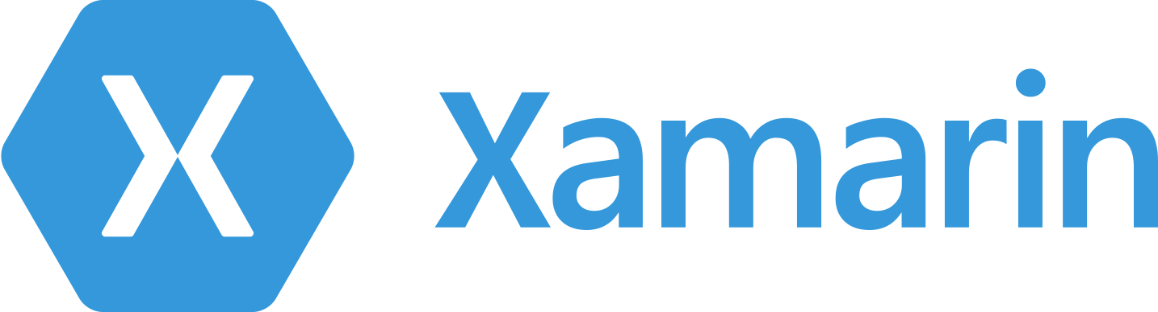





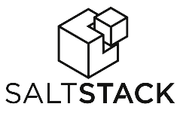


































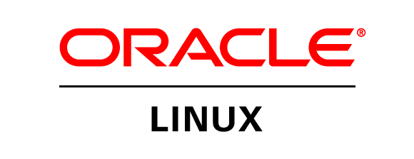
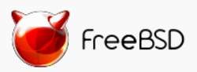

Azure is an open cloud
DevOps
Clients
Management
Applications
PaaS &
DevOps
App frameworks
& tools
Databases &
middleware
Infrastructure
Notes:
P2

Slide 16
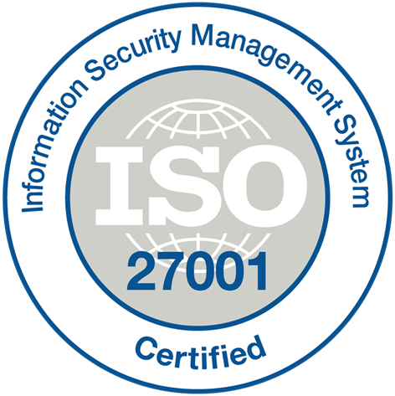
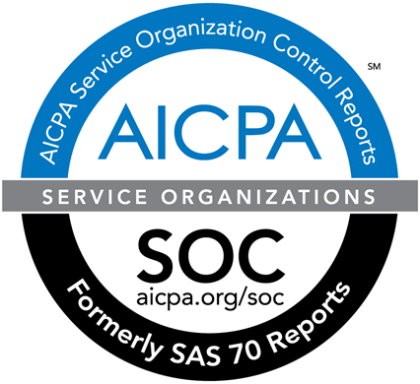




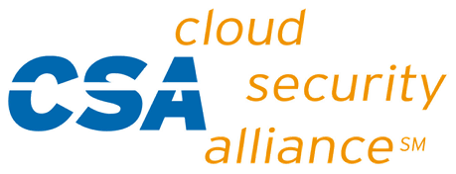
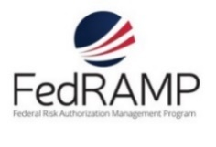




















Azure Compliance
The largest compliance portfolio in the industry
ISO 27001
SOC 1 Type 2
SOC 2 Type 2
PCI DSS Level 1
Cloud Controls Matrix
ISO 27018
Content Delivery and Security Association
Shared
Assessments
FedRAMP JAB P-ATO
HIPAA / HITECH
FIPS 140-2
21 CFR
Part 11
FERPA
DISA Level 2
CJIS
IRS 1075
ITAR-ready
Section 508 VPAT
European Union
Model Clauses
EU Safe Harbor
United Kingdom
G-Cloud
China Multi
Layer Protection Scheme
China
GB 18030
China
CCCPPF
Singapore
MTCS Level 3
Australian Signals
Directorate
New
Zealand
GCIO
Japan
Financial Services
ENISA
IAF
Security Development Lifecycle
Infrastructure security controls
Operational security controls
Compliance

Slide 17
Azure Resource Manager (ARM)

Slide 18
WHAT
IS
Azure
Resource
Manager?

Slide 19
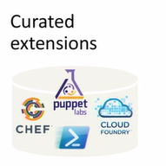
Consistent Management Layer
Azure Resource Manager API

Slide 20
Resource group
Container for multiple resources
Resources exist in one* resource group
Resource groups can span regions
Resource groups can span services
RESOU
R
CE G
R
OUP
*and only one

Slide 21
Resource Tags
x
Name-value pairs assigned to resources or resource groups
Subscription-wide taxonomy
Each resource can have up to 15 tags

Slide 22
Role-based access control

Slide 23
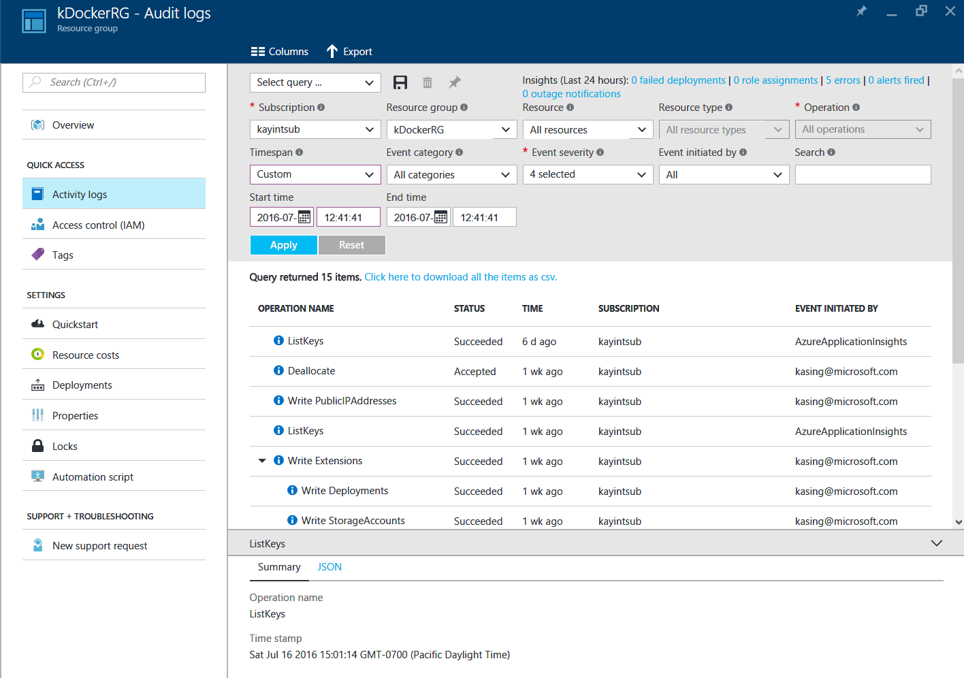
AUDIT LOGS

Slide 24
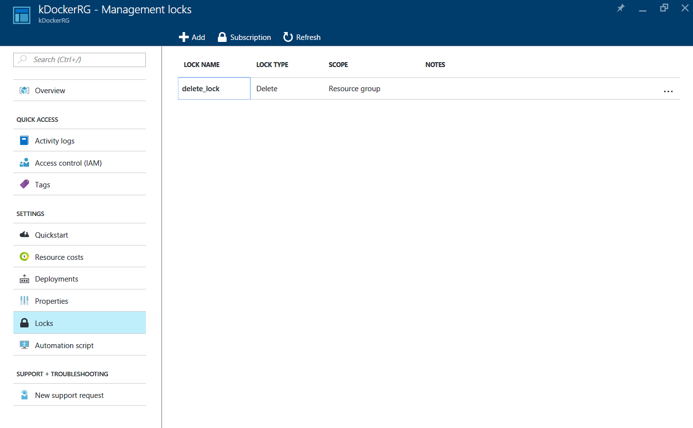
Resource Locks

Slide 25
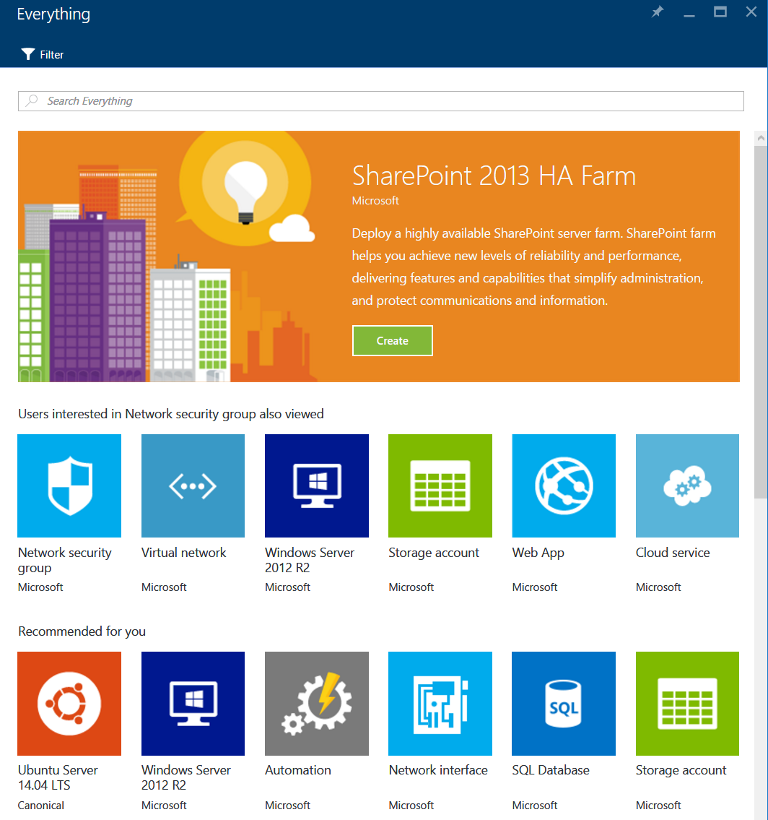
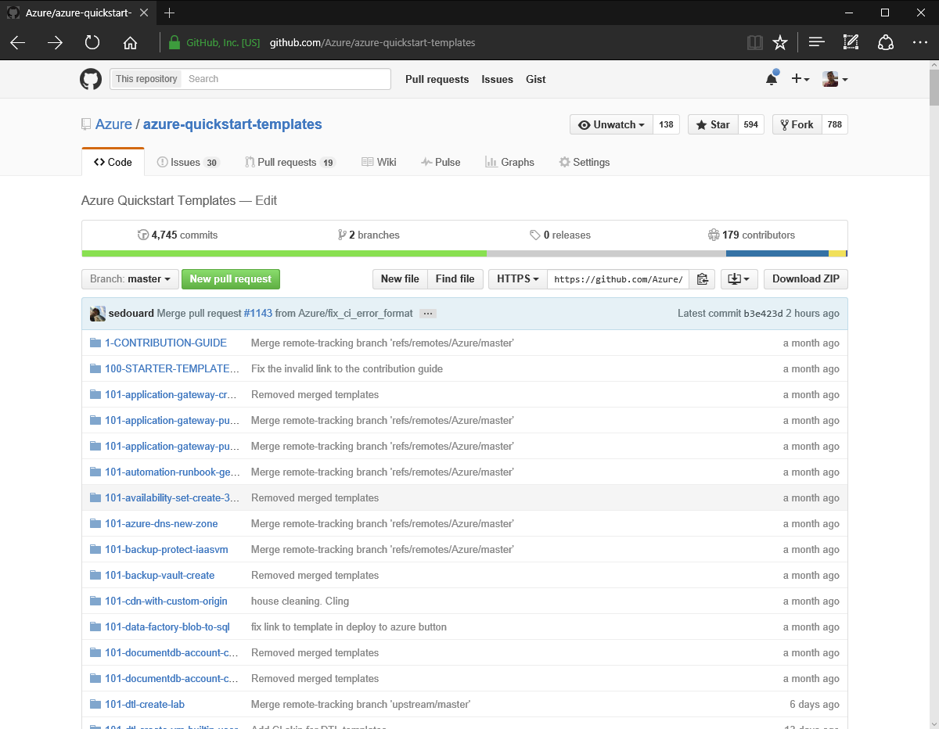
Marketplace
Templates
Github
https://github.com/Azure/azure-quickstart-templates
Notes:
Demo
Marketplace in Portal (Cloudera template, custom UI)
Community templates
Github
Simple windows template, ARM Viz, Portal custom deployment from Quickstart
Azure.com index of templates

Slide 26
ARM Templates
Declarative, model-based specification of resources and their configuration, dependencies, code, and extensions
Repeated deployment and consistent state (idempotent)
Consistent, incremental deployments
Source file, checked-in
Parameterized input/output
SQL-A
Website
[SQL CONFIG] VM (2x)
DEPENDS ON SQL
DEPENDS ON SQL
SQL - A
Website
Virtual
Machines
SQLCONFIG

Slide 27
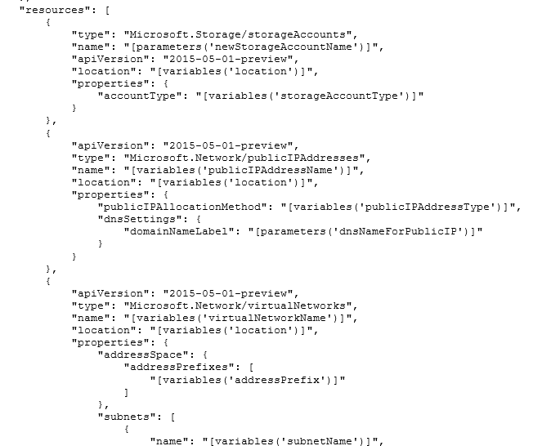
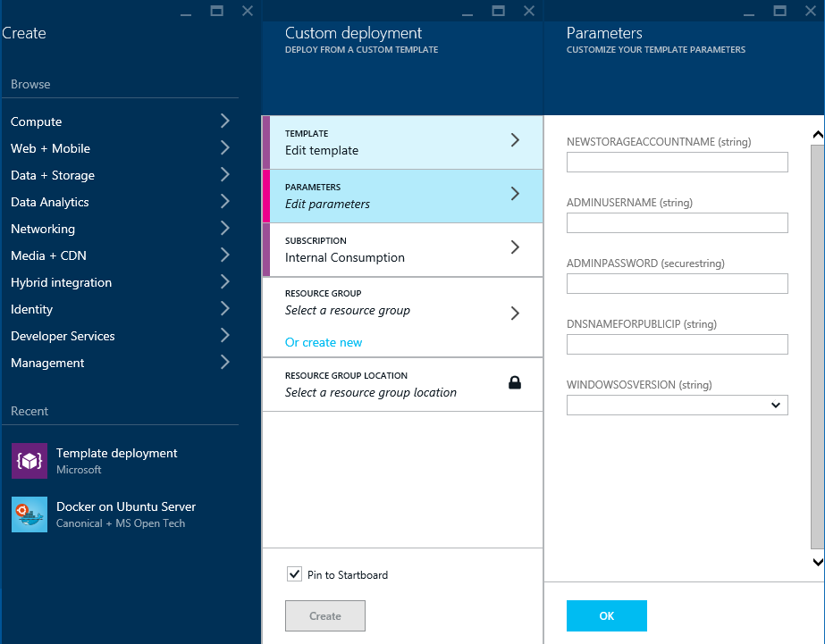
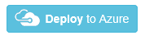
Deploying an App with ARM Templates

Slide 28
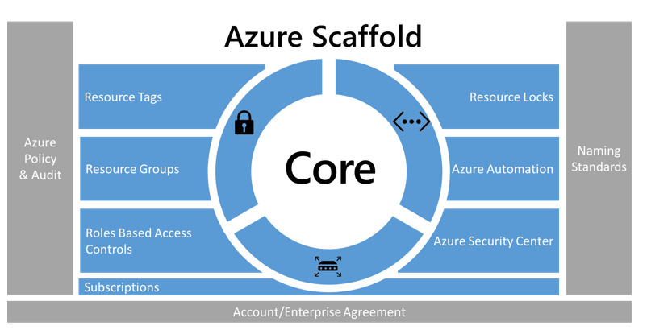
Manage and Govern Your Cloud Resources
Define Azure EA Hierarchy
Naming Standards
Policies and Auditing
Resource Tags
Resource Groups
Role Based Access Control
Azure Resource Locks
Core Networking Resources
Automation
Azure Security Center & Advisor
https://docs.microsoft.com/en-gb/azure/azure-resource-manager/resource-manager-subscription-governance
https://docs.microsoft.com/en-gb/azure/azure-resource-manager/resource-manager-subscription-examples

Slide 29
Evolution of the IT pro skill set
Commoditized skills
Strategic skills for the new era
Solution Manager
UI Designer
UX Designer
Tester SDET
Developer
Application
Operation & Support
Network
Datacenter Engineer
Statistician
Analyst
DBA
Data Analyst
Relationship Manager
trusted advisor
Process Engineer
real-enough time
Edge/Wireless Networking
secure, anywhere access
Data Scientist
business insight
Business Architect
best use of assets
Engineering and DevOps
it works, build for monitoring self-healing
Cloud Architect
secure, anywhere access
Information Architect
trustworthy data

Slide 30
Traditional
IT
Transformed
Key Skills
Datacenter
SI expertise
Solution manager
Data analyst
Tester
BYOD
Cloud architect
Process engineer
Data scientist
DevOps

Slide 31
Traditional
IT
Transformed
Culture
IT metrics
Risk-averse
Fixed mindset
Built here
Business outcomes
Experiment, move quick
Learning mindset
Outside-in innovation

Slide 32
Traditional
IT
Traditional
Transformed
Delivery
Waterfall
Application delivery
Build and change
Help desk
IT vendors
Relationships
Agile sprints
Service delivery
Service models
Unified support model
Strategic suppliers
Trusted advisors

Slide 33

Feature teams work for all delivery approaches
Exploratory
Emphasizes agility and speed
+
Systems of Innovation
Transform
-
More application of waterfall approach
More application of agile approach
Change
Systems of Differentiation
Grow
Governance
-
Emphasizes safety and accuracy
Systems of Record
+
Run
Traditional

Slide 34
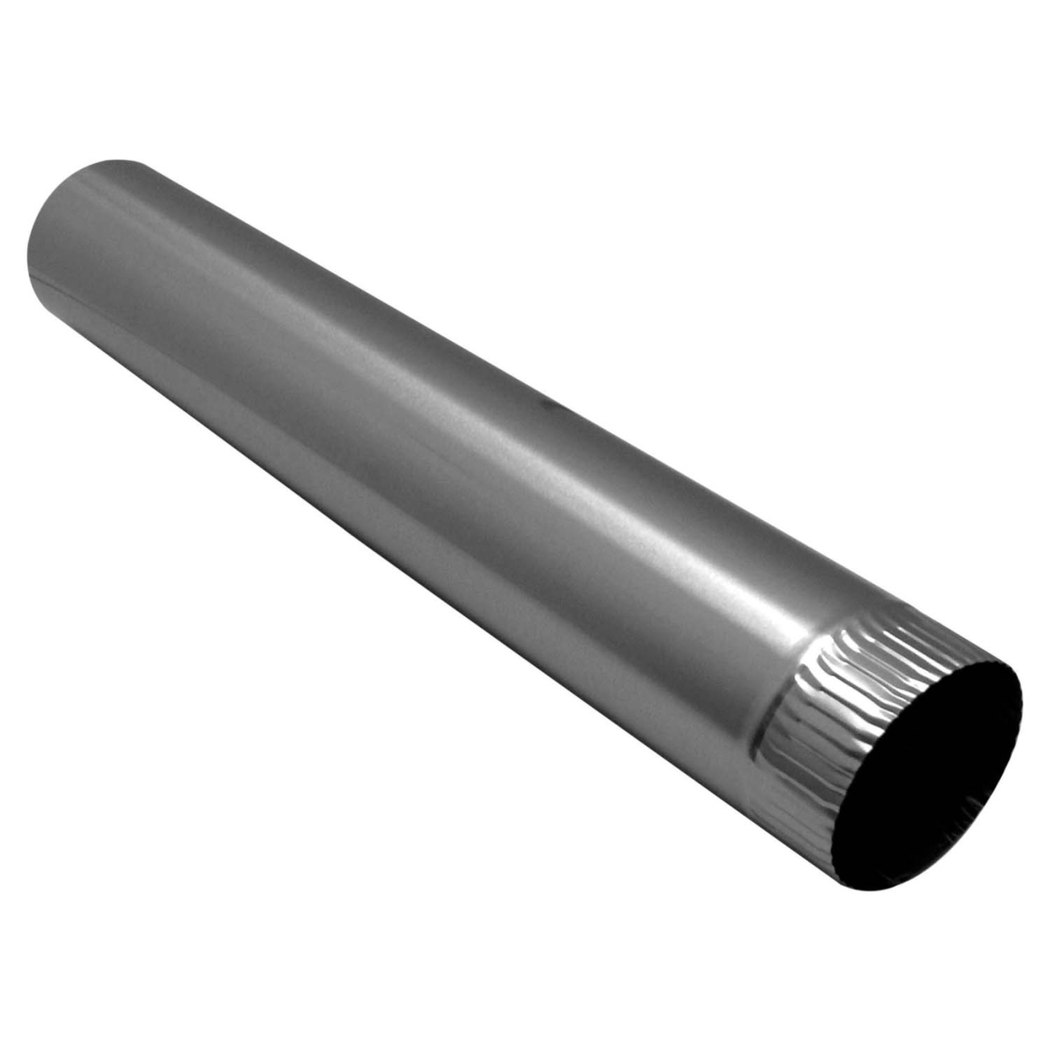

The pieces of IaaS…
Network

Slide 35
The pieces of IaaS…
Resource group
Load balancer
Public IP address
Compute
Virtual machines: Windows | Linux
VM Extensions
Puppet/Chef/DSC
Containers
PaaS
Availability sets: Fault and Update Domains
Network
Virtual networks
Network interfaces
Public IP addresses
Network security groups
Load balancers
VPN gateways
Storage
Storage accounts: Blobs, Tables, Queues
Virtual machine
Virtual machine
Availability
set
Extensions
Extensions
Network security group
Public IP address
NIC
Storage
account
VHD
Network security group
Virtual network
Subnet
Azure Resource Manager
Network Provider
Compute Provider
Storage Provider
Network Infra
Compute Infra
Storage Infra
Notes:
Resource Group
Resources
Resource Providers

Slide 36
Azure networking

Slide 37
The Microsoft network
85 iXP
1.4 M
4 X
15 B
+ CONNECTIONS
TO 1695 NETWORKS
MILES OF FIBER OUR DATA CENTERS
WRAP THE EARTH IN NORTH AMERICAN FIBER
MICROSOFT CLOUD INVESTMENT

Slide 38
The big (network) picture
Virtual network
“Bring your own network”
Segment with subnets and network security groups
Control traffic flow with user defined routes
Azure
virtual network
Users
Internet
Front-end access
Dynamic/reserved public IP addresses
Direct VM access, ACLs for security
Load balancing
DNS services: hosting, traffic management
DDoS protection
Backend connectivity
ExpressRoute VPN Gateways
Backend connectivity
Point-to-site for dev/test
VPN Gateways for secure site-to-site connectivity
ExpressRoute for private enterprise grade connectivity

Slide 39
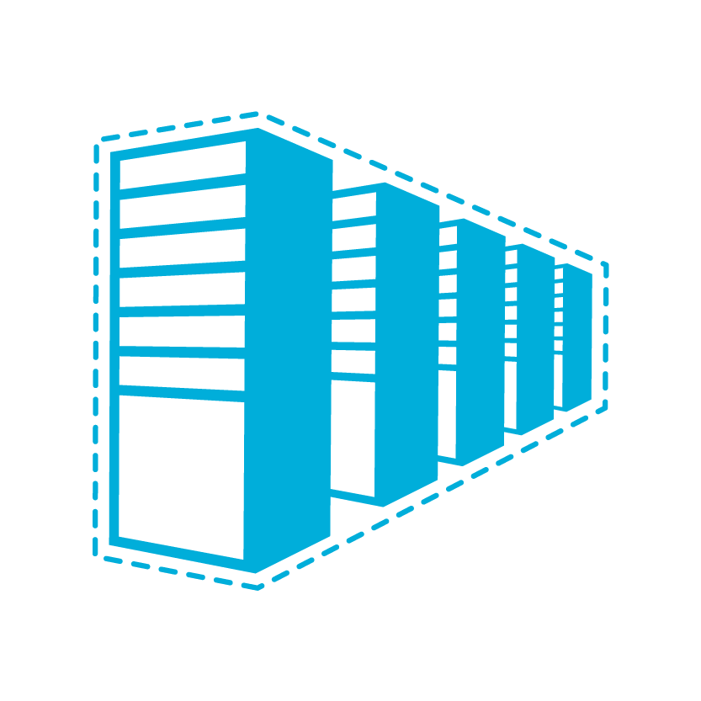


Connectivity options and hybrid offerings
Cloud
Customer
Segment and workloads
Consumers
Access over public IP
DNS resolution
Connect from anywhere
Internet connectivity
Developers
POC efforts
Small-scale deployments
Connect from anywhere
Secure point-to-site connectivity
SMB, Enterprises
Connect to Azure compute
Secure site-to-site
VPN connectivity
SMB & Enterprises
Mission-critical workloads
Backup/DR, media, HPC
Connect to all Azure services
ExpressRoute private connectivity

Slide 40
Picking the right connectivity model
Internet / VPN gateways
Exchange provider
Network service provider
Microsoft Cloud
Microsoft Cloud
Public
internet
Public
internet
Customer Site 3
Customer Site 2
Microsoft Cloud
WAN
Customer Site
Customer Site
ExpressRoute
Partner Location
Customer Site 1
Internet
Connect via an encrypted link over public internet
Peer at an ExpressRoute location, an Exchange Provider facility
Connection from WAN provided by Network Service Provider.
Azure becomes another site on the customer’s WAN.
Internet-based connectivity
ExpressRoute – Provides customer choice and includes access to all Microsoft cloud services

Slide 41

Azure Virtual Network
On-Premises
10.0/16
Logical isolation with control over network
Create subnets with your private IP addresses
Stable and persistent private IP addresses
Bring your own DNS
Use Azure-provided DNS
Secure VMs with input endpoint ACLs
Internet
Direct Internet
Connectivity
S2S VPNs &
ExpressRoute
Azure
VPN GW
Back end
10.3/16
Mid-tier
10.2/16
Front end
10.1/16
AD / DNS
Virtual Network

Slide 42
Regional scope
VNet spans to an entire region
Fully connected private and secure network across datacenters
New services requiring specific SKUs (A8, A9) can be added to same VNet – seamless expansion
Portal
Azure Front End
API
US West
Southeast Asia
RNM
RNM
VNet scope
VNet scope

Slide 43

Interconnected VNets
VNets can be connected through secure Azure gateways
VNets can be in different subscriptions
VNets in same or across regions can be connected
VNet East US
AD/DNS
Cross region secure channel
VNet West Europe
VNet East Asia

Slide 44

Multi-site VNet connectivity
Multiple site-to-site connections
Multiple on-premises sites connect to same virtual network
Sites may be geographically dispersed
Connect up to 10 sites to a virtual network securely over IPsec
Before
With multi-site Vnet connectivity
Connect to multiple on-premises locations
VNet1
US West
VNet2
East Asia
VNet1
US West
VNet2
East Asia
One-to-one
connection
Contoso NorthAm HQ (10.0.0.0/16)
Contoso NorthAm HQ (10.0.0.0/16)
Contoso East Asia (10.3.0.0/16)

Slide 45
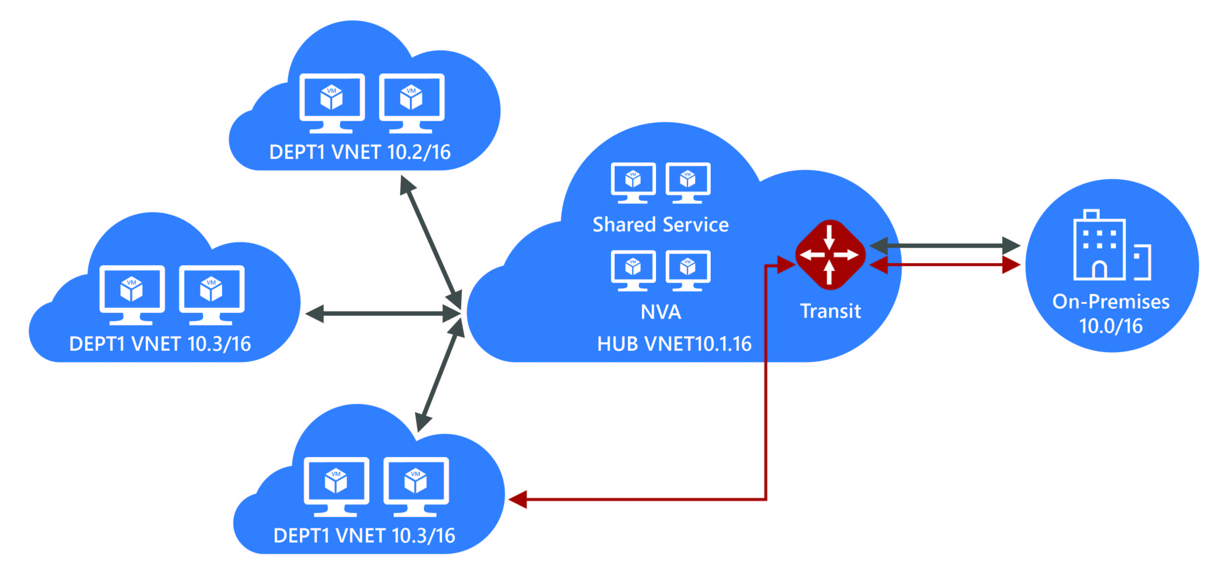
VNet Peering Generally Available
New
Full-mesh direct connectivity
High bandwidth
Low latency
Classic to ARM Peering
Cross subscription
Hub and Spoke configuration
Billing effective from 11/01

Slide 46
Your Virtual Data Center
The cloud is great for individual workloads, but now that we have many isolated workloads, can we get more efficient?
Common Components:
- Infrastructure
- Perimeter Networks
- Monitoring
VNet Peering is the key that unlocks the Virtual Data Center

Slide 47

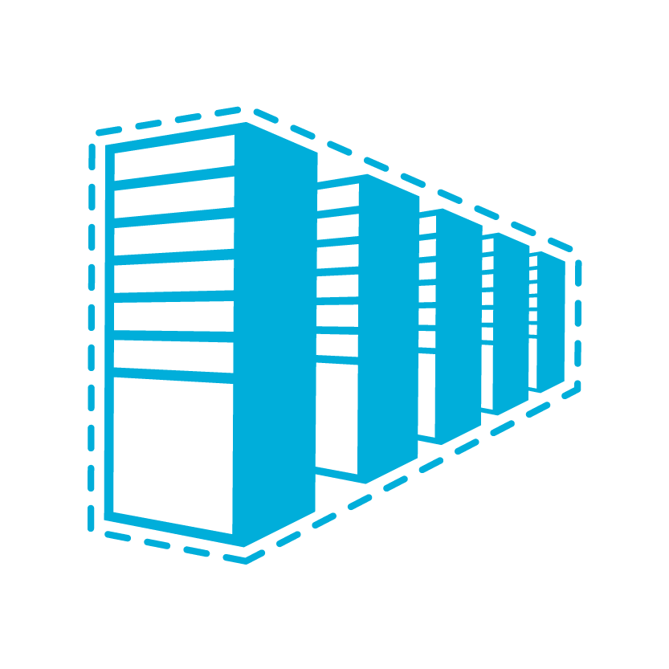
Multi-tier application scenario
Internet
On-Premises
DMZ
DNS Servers
Database
Load Balancer
S2S, ER
App Servers
Load Balancer (Internal)
Web Proxy
VIRTUAL NETWORK

Slide 48
IPv6 for Azure VMs
New
Native IPv6 to VMs
IPv6 clients connect to Azure-based services
Native dual-stack (IPv4+IPv6) VMs
Supported for both Linux & Windows VMs
Available globally
Maximize the reach of your Azure applications
Reach mobile (4G) & IoT devices
IPv6 required by governments and their suppliers
Apple iOS highlighting IPv6 support
Azure
Azure VMs (IaaS)
VM
VM
VM
IPv6
IPv4
Azure Services & Storage
IPv6 (AAAA)
Record
IPv6
VIP
IPv4
VIP
Azure
Load Balancer
Inbound
&
Outbound
Internet
IPv6 Clients & Services
IPv4 Clients and Services
Notes:
This is the first step with more IPv6-enabled features to come but it's significant for a couple of reasons...
First- it's load-balanced IPv6 all the way from the Internet to a native IPv6 endpoint on the VMs. This enables us to support the full range of IP protocols (UDP/TCP/HTTP(S)) and both inbound and outbound initiated native IPv6 connections so your VMs can access IPv6 resources on the Internet.
The VM's are dual-stacked. Dual-stacking allows a single set of VM's to provide services to both IPv4 and IPv6 Internet clients. As you can see in this diagram IPv6 connectivity is provided to the internet and IPv4 connectivity is used for both Internet and communication between VMs and other Azure resources and services.
And you'll also note that Azure DNS supports IPv6 so both Single-A and Quad-A records are automatically created for you when you deploy your IPv6-capable VMs.
Lastly, IPv6 for Azure VM's is available globally- in the majority of Azure commercial regions at launch with the remaining regions and the Azure government regions following soon afterwards.

Slide 49
Security in the cloud
Grouping of network traffic rules as security group
Security groups associated with virtual machines or virtual subnets
Controlled access between machines in subnets
Controlled access to and from Internet
Network traffic rules updated independent virtual machines
Internet
Microsoft Azure
NSG
Front End Subnet
Back End Subnet
NSG
Virtual Network

Slide 50
Network Security Groups (NSG)
Enables network segmentation and DMZ scenarios
Access control list (ACL)
Filter conditions with allow/deny
Individual addresses, address prefixes, wildcards
Associate with VMs or subnets
ACLs can be updated independent of VMs
On Premises 10.0/16
Internet
S2S
VPNs
Internet
√
√
√
√
VPN GW
Back end
10.3/16
Mid-tier
10.2/16
Front end
10.1/16
Virtual Network

Slide 51
Azure Load Balancer Hierarchy
Internet
Azure Service | What | Example
Traffic Manager | Cross-region redirection & availability | http://news.com ➔ apac.news.com ➔ emea.news.com ➔ us.news.com
Azure Load Balancer | In-region scalability & availability | emea.news.com AppGw1 AppGw2 AppGw2
Azure Application Gateway | URL/content-based routing & load balancing | news.com/topnews news.com/sports news.com/images
VMs | Web Servers | IIS, Apache, Tomcat
Azure traffic manager (DNS Load Balancer)
ALB (L4 Load Balancer)
ALB (L4 Load Balancer)
Application
Gateway
Application
Gateway
Application
Gateway
Application
Gateway
VM
VM
VM
VM
VM
VM
VM
VM

Slide 52
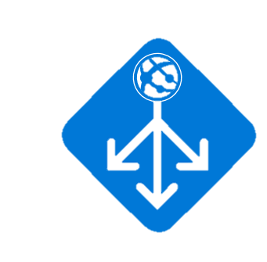
Application Gateway: Layer 7 ADC Features
Security
SSL termination
Allow/block SSL protocol versions
Session & site management
Cookie based session affinity
Multi-site hosting
Content management
URL based routing
Backend management
Rich diagnostics including Access and Performance logs
VM Scale Set support
Custom health probes
fabrikam.com
Application Gateway
Videos
contoso.com
contoso.com/video/*
fabrikam.com
Images
contoso.com/images/*

Slide 53

Web Application Firewall (WAF) - Preview
New
Security
Protect applications from web based intrusions
Built using ModSecurity and Core Rule Set
Availability
Highly available, fully managed
Preconfigured
OWASP* core rule set for most common top 10 web vulnerabilities protection such as
SQL Injection
XSS attacks
Coming Soon
Defining custom rules
×
Application Gateway
Site 1
XSS attack
Valid request
Valid request
WAF
×
Valid request
Site 2
SQL Injection
L7 LB
*Open Web Application Security Project (owasp.org)

Slide 54
Multiple VIPs for Load Balancer
New
Simplify designs and reduce cost
Multiple private VIPs on a load balancer
Reuse of backend ports using DSR
VIP1:80 (LB) → VIP1:80 (VM)
VIP2:80 (LB) → VIP2:80 (VM)
ILB
AG
AG
AG
SQL
SQL
VM
VM
Notes:
Azure Load Balancer now supports multiple VIPs, public and internal, and more degrees of freedom for more high performance load balancing choices.
This enables new scenarios and more efficiency in distributing application loads. (see below for SQL AO background)
Previously public services can now be moved internal to reduce the surface area.
SQL AlwaysOn deployments can consolidate VMs and balance their active replica workloads with Multiple Listeners
Based on these new abilities, SQL AlwaysOn with Multiple Listeners is now available in Preview, with a fully documented scenario to get you up and running quickly.
And more scenarios with Network Virtual Appliances and VMs to come soon.
Background on SQL AlwaysOn Multiple Listeners (enabled by expanding Multiple VIPs to ILB + some of the rule relaxations):
An availability group is a group of databases that fail over together. Each availability group has a listener for clients to connect to.
A SQL VM today can only have one listener, thus practically it can only have one availability group. The multiple listeners support changes this limitation.
The main benefit is that customers can now host multiple availability groups, where some of them are active replicas and some passive replicas.
This allows distributing the active replicas across the VMs in their AlwaysOn deployment and allowing them to distribute the load.

Slide 55
Azure Load Balancer
Client 1
Client 2
Software-based Layer-4 type load balancer
SLB distributes incoming traffic load among healthy service instances in cloud services or VMs defined in a load balancer set
Hash-based 2, 3, or 5 tuple algorithm
Provide routing/access to instances from the Internet
Provide outbound Internet connectivity from Azure with address translation
Source IP-based distribution
VIP
Timeout ++
Azure Load Balancer
Server 1
Server 2

Slide 56
Forced tunneling
“Force” or redirect customer Internet-bound traffic to an on-premises site
Auditing and inspecting outbound traffic from Azure
Needed to meet critical security and IT policy requirements
On-Premises
Internet
S2S
VPNs
Forced Tunneled
via S2S VPN
Internet
VPN GW
Back end
10.3/16
Mid-tier
10.2/16
Front end
10.1/16
Virtual Network

Slide 57
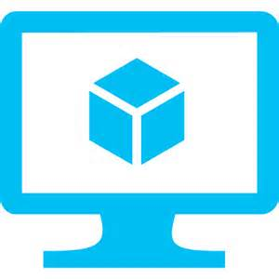

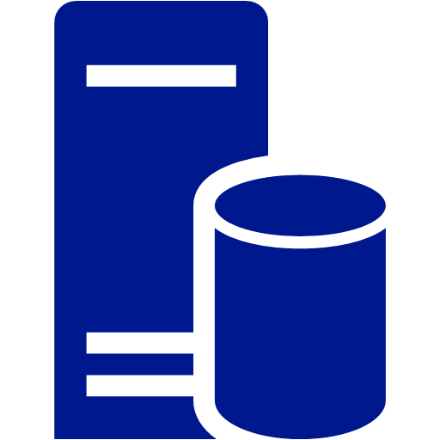
User-defined routes
Control traffic flow in your network with custom routes
Attach route tables to subnets
Specify next hop for any address prefix
Set default route to force tunnel all traffic to on-premises or appliance
Internet
Virtual Network
VM with “IP Forwarding”
System
Route
Front End Subnet
Back End Subnet
System Route
VM/Appliance
User Defined Route

Slide 58

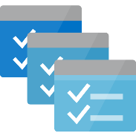






VNET PaaS Service Integration All PaaS Services in a VNET
New
Dedicated PaaS
HDInsight
Batch
App Service
RedisCache
Overview
Customer dedicated PaaS Services deployed to VNETs
Service Tunnel security connects customer VNET to multi-tenet PaaS services
Deploy
Customer VNET
Multi-Tenet PaaS
Storage
Service Tunnel
ACL
SQL DB
SQL DW
UNDER NDA ONLY
Notes:
Key talking points: VNET PaaS Server Integration allows for the deployment of PaaS service instances into a customer VNET and secured tunnel connections between PaaS services and customer VNETs. This means better security and isolation for these services allowing for better compliance and adoption by enterprises.

Slide 59
How it works
The last mile for enterprise
Azure

Slide 60
ExpressRoute
Branch Office 2
Azure
Predictable performance
WAN
High throughput
Branch Office 1
Public internet
Security
Corp HQ
ExpressRoute provides a private, dedicated, high-throughput network connection to Microsoft
Lower cost

Slide 61



ExpressRoute - What is it and why’s it so good?
ExpressRoute provides a private, dedicated, high-throughput network connection from a customer to Microsoft.
Good for your customer!
Predictable performance
High throughput
Private
Supports advanced workloads
OMS (ASR)
EMS (Azure AD)
Big Data
ExpressRoute
ExpressRoute
ExpressRoute
Good for you!
Encourages consumption/active usage
Connect to all Microsoft clouds/workloads
Azure (public/private (Gov)
Office 365/SfB
Dynamics
WAN
Any-to-any (IPVPN) connection
Cloud Exchange co-location
P2P Ethernet connection

Slide 62






















ExpressRoute sites and partners
Atlanta
Chicago Chicago (Gov cloud)
Dallas
LA
NY
Seattle
Silicon Valley
Washington, DC
Washington, DC (Gov cloud)
Amsterdam
Dublin
London
Chennai
Hong Kong SAR
Mumbai
Melbourne
Osaka
Singapore
Sydney
Tokyo
São Paulo

Slide 63
ExpressRoute Enhancements
New
Ultra performance ExpressRoute gateways
Support up to 10G throughput to Vnets – up to 5X improvement!
Improved SLA – 99.95%
Best cloud enterprise connectivity SLA
More insights
Self-help and troubleshooting tools
Improved monitoring, diagnostics, and alerting
BGP routes, traffic statistics, ARP tables
Gateway SKU | Max. Throughput (Gbps)
Standard | 1
HighPerformance | 2
UltraPerformance | 10
Notes:
Highlight the ultra perf
3 columns & more substantials
Pricing for ultra gateways

Slide 64
Secure VPN transit
New
BGP for redundant paths and dynamic routing Automatic shortest path selection and failover
Transit over Microsoft global network Secure connectivity using Internet only for “last mile”
ASN
VNet 3
Full mesh
65030
Redundant paths
Central US
BGP
BGP
ASN
65040
65050
ASN
BGP
BGP
BGP
VNet 2
VNet 1
S2S VPN
West US
East US
S2S VPN
On-Premises
ASN
65020
ASN
65010
On-Premises
Site 4
Site 5

Slide 65
Path diversity for on premises networks
New
Multiple tunnels/paths between Azure VNet and on premises site
Use BGP for reachability detection and path failover
Support on-premises network with multiple ISPs and VPN devices
VNet1
East US
ASN 65010
10.11.0.0/16
10.11.0.0/16
IPsec/IKE S2S VPN tunnel 1
Active tunnels with BGP failover
On Premises VPN 1
On Premises
Site 5
ASN65050
10.51.0.0/16
10.52.0.0/16
Azure VPN
IPsec/IKE S2S VPN tunnel 2
On Premises VPN 2

Slide 66
Dual Redundancy with Active-Active gateways
New
Zero downtime during planned maintenance
From active-standby to active-active
Support both cross-premises and VNet-to-VNet connectivity
Spreading traffic over multiple tunnels simultaneously
VNet1
East US
ASN 65010
10.11.0.0/16
10.11.0.0/16
Azure VPN
On Premises VPN 1
On Premises
Site 5
ASN65050
10.51.0.0/16
10.52.0.0/16
Azure VPN 2
On Premises VPN 2

Slide 67
ExpressRoute Premium add-on
Global connectivity
Link a virtual network from any Azure region to your ExpressRoute circuit
More IP route prefixes
Increase limit to 10,000 routes (from 4,000)
Connect more Azure VNets (10 for standard)
How to enable Premium:
PS C:\> Set-AzureDedicatedCircuitProperties -ServiceKey $myServiceKey -Sku Premium

Slide 68
Sharing ExpressRoute connections
Share an ExpressRoute circuit across other subscriptions
Circuit owner must authorize and can revoke
Owner gets billed for usage
Microsoft Azure
Storage
SQL DB
Websites
On-Premises Network
IT
AD / DNS
Proxy /
Internet edge
ExpressRoute
SQL Farm
IIS Servers
Sales
AD / DNS
Monitoring
R&D
AD / DNS
Marketing
Exchange
AD / DNS
AD / DNS

Slide 69





ExpressRoute and Microsoft Clouds
Microsoft
peering
Public peering
Partner Edge
Primary
circuit
Microsoft Edge
Customer’s network
Secondary
circuit
Traffic to Office 365 Services
Traffic to public IP addresses in Azure
Traffic to Azure Virtual Networks
Private peering

Slide 70
Path Diversity for HA and DR
One VNet can be linked to multiple circuits
Circuits can be through different service providers in different locations
HA + DR = Active-active in one location + active-active in second location
Aggregate throughput determined by VNet gateway SKU
Customer can choose preferred link (coming soon)
Azure
US West
Azure
US East
Silicon Valley
Wash DC
AT&T
AT&T
Customer
on-premises

Slide 71
The pieces of IaaS…
Storage

Slide 72
Azure Storage Services
Blobs
Highly scalable, REST based cloud object store
Block Blobs: Sequential file I/O
Page Blobs: Random-write pattern data
Tables
Massive auto-scaling NoSQL store
Dynamic scaling based on load
Scale to PBs of table data
Fast key/value lookups
Queues
Reliable queues at scale for cloud services
Decouple and scale components
Message visibility timeout and update message to protect against unreliable dequeuers
Disks
Persistent disks for Azure IaaS VMs
Built on page blobs
Premium Storage Disks: SSD based, high IOPS, low latency
Files
Fully Managed File Shares in the Cloud
Map to file share, standard file system semantics
“Lift and shift” legacy apps
Code against (REST API)
Use on Windows & Linux VMs

Slide 73

Azure Storage
LRS – three local copies
ZRS – zone copies w\in single facility & region
GRS is recommended over ZRS or LRS for maximum durability. Enabled for Storage Account by default. 6 copies of data – three times each in two data centers
RA-GRS Read-Access geo-redundant. Allows read access at secondary when primary region becomes unavailable.
Notes:
Read Access Geo Redundant on exam

Slide 74
Virtual machine storage architecture
Azure Virtual Machine
C:\
OS Disk (1023 GB)
D:\
Temporary Disk
(Contents can be lost)
E:\, F:\, etc.
Data Disks (1 TB)
Disk Cache
Azure Blob

Slide 75


Managed disks
New
Simplified management for performance and scale
Overview
Simplifies management to avoid capacity planning mistakes and easier to scale
Integrates directly with virtual machine scale sets
WHAT THE ADMINISTRATOR SEES
BEHIND THE SCENES
500 IOPS PER DISK
MANAGED DISK (2000 IOPS)
STORAGE ACCOUNT
Notes:
Key talking points:
Managed disks is a new feature that is cross cutting. You will see different aspects of it when we discuss security and flexibility improvements later in the presentation.
Managed disks simplifies scale by taking away the need for the administrator to know about service limits of storage accounts and ensure that IOPS and throughput capabilities are easy to understand.
Managed disks also integrate directly with virtual machine scale sets to automatically scale the front end compute and the backend storage.

Slide 76
Managed disks Simple scalability and high resiliency
New
AVAILABILITY SET
Overview
Managed disks simplifies the experience for managing storage and capacity planning in virtual machines and increases resiliency by abstracting the underlying architecture from the user and minimizing mistakes
Managed disks honor fault domains within an availability set and will deploy disks into storage accounts in the same fault domain as the virtual machines for additional physical redundancy
FAULT DOMAIN 0
FAULT DOMAIN 1
FAULT DOMAIN 2
STORAGE ACCOUNT
STORAGE ACCOUNT
STORAGE ACCOUNT
Storage Account 2
Notes:
Key talking points:
Today disk management is a fairly complex process. Users must understand service limits of storage accounts and directly manage page blobs in one or more storage accounts to ensure they have enough storage capacity and IOPs. Availability is also an issue as a storage account could potentially be a single point of failure.
Managed disks solves the availability problem by ensuring the disks are created on physically separate stamps of storage when provisioned with VMs in an availability set.

Slide 77
Virtual machine storage
Azure storage page blobs
3 – 6 copies
VHD disks
1 TB per disk
500 IOPs (standard)

Slide 78
Premium storage
Up to 64 TB of storage per VM
>80,000 IOPS per VM
5,000 IOPS per disk
Less than 1ms read latency (cache)
~5 ms read/write (no cache)

Slide 79
Premium Storage
Regular Azure storage is primarily HDD based
Premium Storage is based on SSD storage
Provides a predictable level of performance compared to unpredictable MAX performance for regular storage
Three disk types and the size used for a VHD controls which disk type is selected
Must be used with DS or GS-series VMs which have varying IOPS limits
Disk Types | P10 | P20 | P30
Disk Size | 128 GB | 512 GB | 1024 GB
IOPS per Disk | 500 | 2300 | 5000
Throughput per Disk | 100 MB/sec | 150 MB/sec | 200 MB/sec
Notes:
You do not specify a disk type, the disk type is chosen based on the size of disk you create and rounder up to the applicable disk type. Therefore any disk 128 GB or smaller will be a P10, any disk between 129 and 512 will be a P20 and any disk over 512 will be a P30.
https://azure.microsoft.com/en-us/documentation/articles/storage-premium-storage-preview-portal/
http://azure.microsoft.com/en-us/pricing/details/storage/ - use east us2 to see pricing
http://azure.microsoft.com/blog/2014/12/11/introducing-premium-storage-high-performance-storage-for-azure-virtual-machine-workloads/
http://azure.microsoft.com/en-us/documentation/articles/storage-premium-storage-preview-portal/
http://azure.microsoft.com/blog/2015/04/16/azure-premium-storage-now-generally-available-2/
http://azure.microsoft.com/en-us/pricing/details/storage/ - use east us2 to see pricing
DS required as to ensure predictable performance local SSD is used along with RAM to form a Blobcache. This is why DS has smaller temp drive than D (because delta is used for caching)
GS coming soon allow premium storage to be used with G series
Q. What are the limits associated with Azure Premium Storage?
A. For regular Azure storage accounts there is an IOPS limit and a capacity limit. Premium Storage accounts have a 35 TB limit but not a fixed IOPS limit. Instead the capacity limit indirectly restricts the amount of IOPS per Premium Storage account. Based on the 35 TB limit it would be possible to get around 150,000 IOPS from a single Premium Storage account.

Slide 80
Virtual machines

Slide 81

Virtual Machines - Compute families
A
D
F
G
Entry Level
General Purpose VMs
Compute
Optimized VMs
Large Memory VMs
>80,000 IOPs
Premium Storage
Dev/Test and entry-level workloads
Earliest generation, HDD
100 ACU/core
Good combination of memory, SSD for most common production applications
Memory-intensive variants
210 ACU/core
Compute-intensive apps like Gaming, Analytics
More CPU to memory ratio
210 ACU/core
Large VMs for large databases requiring fast Storage
Intel Haswell processor with 0.5TB RAM
180 ACU/core
Highest Value
Largest Scale-up
Notes:
Azure offers a broad set of compute family that customers can take advantage from dev test to large database workloads

Slide 82

New compute size options
New
>80,000 IOPs
Premium Storage
A
D
F
L
G
M
A
Av2
B
D
Dv2
Dv3
F
N
G
H
Ev3
Av2
Av2
Av2
Av2
Av2
Av2
Av2
Av2
HIGHEST VALUE
LARGEST SCALE-UP
UNDER NDA ONLY
Notes:
Key talking points:
There are several new instance sizes that will be introduced over the next 6 months.
Each of these instance sizes are designed for increased performance and flexibility with capabilities tailored to specific workloads: B, Dv3, Ev3, L & M Series.

Slide 83
New compute size options
New
CY17-Q2
CY17-Q2
CY17-Q1
CY17-Q2
CY17-Q2
CY16-GA
A
B
D
F
Dv3
L
G
Ev3
M
A
Av2
D
Dv2
F
G
N
H
Av2
Av2
Small
Workloads
General Purpose & Application Workloads
Optimized for Storage Workloads
Optimized for Database Workloads
Optimized for largest enterprise applications including SAP HANA
Optimized for large SAP HANA workloads
HIGHEST VALUE
LARGEST SCALE-UP
More than doubling the compute offerings in 2017
UNDER NDA ONLY
Notes:
Key talking points:
There are several new instance sizes that will be introduced over the next 6 months.
Each of these instance sizes are designed for increased performance and flexibility with capabilities tailored to specific workloads

Slide 84
Virtual machine sizes
Compute Instance Name | Virtual Cores | RAM
Extra Small (A0) | Shared | 768 MB
Small (A1) | 1 | 1.75 GB
Medium (A2) | 2 | 3.5 GB
Large (A3) | 4 | 7 GB
Extra Large (A4) | 8 | 14 GB
A5 | 2 | 14 GB
A6 | 4 | 28 GB
A7 | 8 | 56 GB
A8 | 8 | 56 GB
A9 | 16 | 112 GB
Compute Instance Name | Virtual Cores | RAM
D1 | 1 | 3.5 GB
D2 | 2 | 7 GB
D3 | 4 | 14 GB
D4 | 8 | 28 GB
D11 | 2 | 14 GB
D12 | 4 | 28 GB
D13 | 8 | 56 GB
D14 | 16 | 112 GB
Compute Instance Name | Virtual Cores | RAM
G1 | 2 | 28 GB
G2 | 4 | 56 GB
G3 | 8 | 112 GB
G4 | 16 | 224 GB
G5 | 32 | 448 GB
*Note: Azure adds new VM sizes on a regular basis the list above is dates. Please see the link below for the current listing
https://azure.microsoft.com/en-us/documentation/articles/virtual-machines-windows-sizes/

Slide 85
Datacenter architecture
Region can be composed of multiple datacenters
Datacenters are divided into “clusters”
Each rack provides a unit of fault isolation
Datacenter
Routers
Aggregation Routers and
Load Balancers
Agg
Agg
Agg
Cluster 1
Cluster 2
Cluster 3
Cluster 4
Cluster 5
Cluster Network Aggregation
Agg
Agg
Agg
Agg
Agg
Agg
Top of Rack
Switches
TOR
TOR
TOR
TOR
TOR
TOR
TOR
TOR
TOR
TOR
TOR
TOR
TOR
TOR
TOR
Racks
…
…
…
…
…
Servers
…
Servers
Servers
Servers
Servers
Servers
Servers
Servers
Servers
Servers
Servers
Servers
Servers
Servers
Servers
Power Distribution Units
PDU
PDU
PDU
PDU
PDU
PDU
PDU
PDU
PDU
PDU
PDU
PDU
PDU
PDU
PDU

Slide 86

Availability sets
Availability set
SLA high availability
Hardware and software
Windows and Linux
Virtual Machine
Virtual Machine
SQL Server
Primary
SQL Server
Secondary
SLA 99.95

Slide 87

Availability sets
Physical Machines
Power Unit
Rack Switch

Slide 88

Availability sets
Physical Machines
Power Unit
Rack Switch
VM1
VM2
VM2
VM1
Availability Set

Slide 89
Single instance SLA on virtual machines Guaranteed service level availability with a single virtual machine
New
VIRTUAL NETWORK
Overview
Azure will guarantee availability at 99.9% with only a single instance!
Requires Premium Storage
AVAILABILITY SET – 99.95% SLA
SINGLE VM – 99.95% SLA
Notes:
Key talking points:
Today for all Internet facing Virtual Machines that have two or more instances deployed in the same Availability Set, we guarantee you will have external connectivity at least 99.9% of the time.
Azure will offer a service level agreement for a single virtual machine when the virtual machine is deployed with SSD backed premium storage.

Slide 90

Performance advancements at no additional cost!
New
Improved performance for all VMs
Utilizes hardware advancements to increase VNET throughput by 33% to 50%
Increased IOPS to storage
Free up CPU cycles to scale better
OS agnostic
Linux and Windows
Global deployment will complete in 2016
Improvements rolling out in phases and we will publish performance ranges
Performance increase across all VM SKUs globally

Slide 91
Accelerated Networking: best cloud performance!
New
Consistent low latency network performance
Provides SRIOV to the VM
10x latency improvement
Increased packets per second (PPS)
Reduced jitter means more consistency in workloads
Highest bandwidth VMs of any cloud
DS15v2 & D15v2 VMs get up to 25Gbps – in preview now
Enabling performance sensitive applications
1.5x improvement for Azure SQL DB In-Memory OLTP transactions

Slide 92

Accelerated Networking Internals
New
SDN/Networking policy applied in software in the host
Hardware accelerators used to apply all policies

Slide 93

Multiple NICs in Azure VMs
Multiple NICs enable virtual appliances in Azure
Up to 4 NICs per VM
MAC/IP addresses persist through VM life cycle
Separate front end/back end traffic, and management-data planes
Azure Virtual Machine
NIC2
NIC1
Default
10.2.3.33
10.2.2.22
10.2.1.11
Azure Virtual Network
VIP: 133.44.55.66
Internett
Back end
Subnet
App
Subnet
Front end
Subnet

Slide 94




VM extensions
Extending the power of your VM
Enable easier management
Support partner ecosystem
Full control still with you!
IaaS extended
Curated Extensions
Agent
Azure

Slide 95

VM extensions
Microsoft Antimalware
Chef
Puppet
Site 24x7
Control-M BMC Software
HPE Security Fortify Execution
PowerShell DSC
Trend Micro
ESET File Security
PowerShell DSC
Dynatrace

Slide 96
Azure Security

Slide 97

Assume Breach
Notes:
In todays cyber world Microsoft has change our security stance to assume breach and it providing technology to protect against insider threats.

Slide 98

Introducing Microsoft Advanced Threat Analytics
An on-premises platform to identify advanced security attacks before they cause damage
Behavioral Analytics
Detection for known attacks and issues
Advanced Threat Detection

Slide 99

Microsoft Advanced Threat Analytics
Security issues and risks
Broken trust
Weak protocols
Known protocol vulnerabilities
Malicious attacks
Pass-the-Ticket (PtT)
Pass-the-Hash (PtH)
Overpass-the-Hash
Forged PAC (MS14-068)
Golden Ticket
Skeleton key malware
Reconnaissance
BruteForce
Abnormal Behavior
Anomalous logins
Remote execution
Suspicious activity
Unknown threats
Password sharing
Lateral movement

Slide 100

Azure Security Center
Securing the platform
Empowering you
RED TEAM
BLUE TEAM
Notes:
Security is built into the services we provide to our customers, and embedded within our development processes, infrastructure, operations, and compliance.
Assume Breach is an example of operational innovation for securing your business. It is unique to Microsoft, and is a key operational practice that it uses to harden its cloud services. Here’s how it works:
The red team simulates real-world attacks at the network, platform, and application layers.
The blue team detects, protect against, and recovers.
Identifying and ejecting attackers, limiting what access an attacker would have if various layers were breached – we do this though techniques like segregation of duties, and how quickly we can restore the environment in the event of a breach. By constantly challenging the security capabilities of the service, Microsoft can stay ahead of emerging threats and be prepared to act quickly to threats.
On the right side, we provide services to empower you to protect your assets, for example,
Azure Security Center helps you prevent, detect and respond to threats with increased visibility and control over the security of all your Azure resources. It provides a central view of security across your subscriptions, and enables you to set policies and monitor security configurations. Policy-driven recommendations guide resource owners through the process of implementing security controls and enable rapid deployment of integrated Microsoft and partner security solutions. Security-related events from across your Azure deployments are automatically collected and analyzed using Microsoft global threat intelligence and expertise to identify actual threats and reduce false alarms. The resulting real-time alerts offer insights into the attack campaign and suggest ways to remediate and recover quickly.

Slide 101

Set security policies for subscriptions and resource groups

Slide 102


Monitor the security state of resources – quickly identify vulnerabilities

Slide 103


Gain insight into the security state of subscriptions in Power BI

Slide 104

Why Microsoft is in a unique position
APT hunters – OS Security, Exploit & Malware Researchers, & Threat Intelligence
Over 1M Microsoft corporate machines
New code, new products, new files
1.2 Billion Windows machines reporting
11M Enterprise machines reporting
1M files detonated daily
2.5T URLs indexed and 600M reputation look ups
Advanced detection algorithms & Statistical modelling
Most are local admins
Hundreds of labs, malware enclaves
We have a challenging network
…plus unique optics…
…and world class security expertise
Notes:
OPTICS + DATA + EXPERTISE = market leading INTELLIGENCE
We believe that MS is in a very unique position to play in this field
MS network is huge -
With over 1M machines, users with admin rights on every machines, thousands of users flighting or dogfooding new versions of Microsoft services, developers generating countless new files, processes and scripts daily, pen-testers, security analysts and malware researchers dealing with hack tools and malware, people reversing vulnerabilities, hundreds of labs with thousands of machines being stood up and torn down daily, networks scraping the internet for content and delivering content to millions of machines, several huge islands of service backends and 400K strong corporate network – protecting the MS network is a huge achievement of engineering and security expertise.
But our size and complexity together with our product portfolio, reach and optics into the world are also the things that provide us with the clear advantage in helping enterprises get better at protecting themselves.
Our immense security graph provides big-data security analytics that look across aggregate behaviors to identify anomalies – informed by anonymous non-personally identifiable information from over 1 billion Windows devices, 2.5 trillion indexed URLs on the Web, 600 million reputation look-ups online, and over 1 million suspicious files detonated every day.
This data is then augmented by expertise from our own world-class security experts and ATP experts from across the globe, who are uniquely equipped to detect these kind of attacks.

Slide 105


Windows Defender ATP
helps enterprise customers detect and remediate Advanced Attacks and data breaches
Client side dynamic endpoint behavioral sensors and loggers, works side by side with any existing endpoint security technology
Powered by cloud Machine Learning Analytics over the largest sensor array in the world
Enhanced by the community of our Hunters, researchers and threat intelligence
Built into
Notes:
Windows Defender ATP uses a combination of client technology built into Windows 10 and our robust cloud service.
Windows Defender ATP is composed of 3 parts:
The Client – an agent built into the OS (Windows 10 Anniversary update and later) responsible to log everything that happens on the client machine and send it over to the cloud
Cloud analytics service– leverage huge dictionary of IOAs and signals collected across it’s eco-system of Windows customers, enterprise cloud products and online assets. It runs on a scalable Big Data, a processing service to draw fast insights, identifying attacks and use many ML algorithms that were created in the last years by AND
Microsoft and community intelligence, our Hunters and researchers that are investigating the data and finding and creating new behavioral patterns and correlating it with existing knowledge from the security community

Slide 106

Microsoft hybrid cloud management Simplified guest and workload management, on-premises and in the cloud
Microsoft System Center
Microsoft Operations Management Suite
VMWare
LINUX
WINDOWS
LINUX
WINDOWS
HYPER-V
HYPER-V
LINUX
LINUX
WINDOWS
WINDOWS
VMWare
LINUX
WINDOWS
On-premises datacenter
Public and hosted clouds
Azure or AWS
Log analytics, desired state configuration, automation, security, backup, site recovery

Slide 107














Azure Operational Insights (Log analytics)
Log Management– Collect, correlate and visualize all your machine data
Correlate & Search data from multiple sources
Collect custom data types
Build dashboards powered by search queries
Virtual
Machines
Hosts
Troubleshooting
SEARCH SERVICE
Forecast future capacity needs and pinpoint performance bottlenecks
Check your update and malware protection status
AZURE BLOB
DATA PROCESSING ENGINE
Cloud
PORTAL
Networks
Database
Operation
Insights
Machine data
from
on-premises and Azure
Operational Insights
Insights
Identify security breaches
Meet compliance requirements for auditing
Analyze security data
Security Logs
Web Servers
Security Intelligence
Key Benefits:
REAL TIME
SEARCH
READY MADE INTELLIGENCE
DASHBOARDS
& REPORTING
SCALABLE

Slide 108































































Activity Log
IoT Hub
Integrate with any app
Application Gateway
Key Vault
Application Insights
Load Balancer
Automation
Logic App
Batch Service
Network Security Group
Office 365
Email
Webhook
Cognitive Services
Search
Containers
Service Bus
OMS Log Analytics
Azure
Data Lake Store
Service Fabric Cluster
Automation
Event Hubs
SQL Database
Alerts
HDInsight HBase
Web App/Farm
ITSM
HTTPS
Dashboards
CentOS
Oracle
Ubuntu
Windows
Hybrid,
On-Prem,
Any Cloud
Debian
RHEL
SLES
Events, Properties,
Performance
OMS Repository
Log Search
Power BI
Active Directory
Security & Audit
Excel
Antimalware
Service Map
Collector API
Search API
Capacity & Performance
SQL Server
Change & File Tracking
Update Management
Network Performance
VMWare Monitoring
Operations Manager
Wire Data
Ingest logs from any device or app
Export to any app

Slide 109







Connected Data Sources for OMS
Azure Diagnostics
Azure Storage
Windows Events
Windows Performance Counters
Application
Insights
HTTP Data Collector API
Azure Activity Logs
OMS
Syslog
Custom Fields
Linux Performance Counters
IIS Logs
Custom Logs

Slide 110
Demo OMS Log analytics

Slide 111
Traffic Manager

Slide 112

Traffic Manager: DNS-based load balancing
www.yourapp.com
Load-balancing policies
Performance – Direct to “closest” service based on network latency
Round-robin – Distribute equally across all services
Failover – Direct to “backup” service if primary fails—also
included in other policies

Slide 113
Traffic Manager nested profiles
Enable richer profiles with greater flexibility for large/complex deployments
Example: Cross-region failover within a geo, plus in-region flighting
Level 1: Route to user’s nearest geo (US, EU, ASIA)
Level 2: Route to nearest region, with cross-region failover within the geo
Level 3: Load-balance within the region, divert 1% for flighting
US West
US East
Europe North
Europe West
Cloud Services

Slide 114
Azure recovery services

Slide 115
Why business continuity/DR?
Loss of Data & Service
Cost of Disruption
Brand & Equity
Compliance
Organizations experience 4+ disruptions each year
Average cost of the disruption is $1.5M/hour
Loss of reputation is often irreparable
Clients want to partner with orgs that have BCDR in place
Recovery times range from 1hr to 9hrs
4 in 10 businesses do not reopen after a major disaster
Customer trust and brand severely impacted
Protection & recovery key tenet in most compliances
Downtime = Loss of business to competition or closure
Source: EMC Digital Universe with Research and Analysis by IDC, 2014
Source: IDC: Measuring Cost of Downtime and Recovery Objectives Among U.S. Firms, IDC QuickPoll Survey July 2013 and Storage User Demand Study 2013
Source: Federal Emergency Management Agency (FEMA)

Slide 116
Azure Site Recovery and Azure Backup
Microsoft Azure
Datacenter
Disaster Recovery
DevTest
Application Analytics
Cloud Bursting
Migration
Azure Site Recovery
Backup
Long-term Retention
Azure Backup

Slide 117














StorSimple
Primary Storage
Archival Storage
Customer Data Center
Disk-based Backup
Applications in Physical or Virtual Servers
StorSimple
Remote Replication
Windows File Server
Linux File Server
VMware Server
Tape backup and DR
iSCSI
StorSimple Hybrid Storage Array
Enterprise SAN storage
Inline de-dupe, compression, & automatic tiering
Azure Data Center
Internet
Automated offsite data protection using cloud snapshots
Highly efficient, location-independent disaster recovery
iSCSI
Data mobility for enterprise data
Consolidated storage and data management
StorSimple Virtual Appliance
Azure-based Applications
StorSimple Manager

Slide 118

Azure Site Recovery + NetApp
Enable availability on demand for SAN-based Hyper-V workloads
Protect Tier 1 Hyper-V workloads to Azure, and benefit from the performance characteristics achieved by placing NetApp storage in an Equinix datacenter
Azure ExpressRoute connectivity to improve throughput between storage and Azure compute.
ASR’s Replication to Azure functionality is used to replicate the OS drives of the Hyper-V workload
ASR’s Array-Based Replication functionality is used to mirror data between on-premises and NetApp private storage

Slide 119

On-premises to on-premises protection (site-to-site)
Orchestrated disaster recovery
On-premises to Azure protection (Site-to-Azure)
Microsoft Azure Site Recovery
Microsoft Azure Site Recovery
Microsoft Azure Site Recovery
Microsoft Azure Site Recovery
Orchestration Channel
Download InMage Scout
Orchestration and Replication: Hyper-V Replica, SQL AlwaysOn
Orchestration and Replication: InMage Scout
COMING SOON!
InMage Scout
Orchestration and Replication channel: InMage Scout
InMage Scout
InMage Scout
Replication channels:
Hyper-V Replica, SQL AlwaysOn, SAN
Primary Site
Recovery Site
Primary Site
Recovery Site
Primary Site
Primary Site
Hyper-V
Hyper-V
VMware / Physical
VMware / Physical
Hyper-V
VMware / Physical
Key features include:
Automated VM protection and replication
Remote health monitoring
Near zero RPO
No-impact recovery plan testing
Customizable recovery plans
Minimal RTO – few minutes to hours
Orchestrated recovery when needed
Replicate to—and recover in—Azure
Heterogeneous physical and virtual support

Slide 120
VMware Site-to-Azure
Azure
Customer 1 Source: VMware VMs & Physical Servers
Customer 1 Source: VMware VMs & Physical Servers
Microsoft Azure Site Recovery
Microsoft Azure Site Recovery
Data Channel/Control Channel
ExpressRoute or Public Internet
Customer 1
Customer 2 Source: VMware VMs & Physical Servers
Customer 2 Source: VMware VMs & Physical Servers
ASR PAAS Service. Data replicates to customer storage accounts. No Infra /Appliance VM needed in Azure
Process Server
Used for Caching, Compression, & Encryption
Config Server
Used for Centralized Management
Mobility Service
In-guest light weight mobility service. Captures all data writes from memory
PS and CS can be co-located on same VM for up to 200 VM replication

Slide 121



Microsoft solutions
Breadth and depth solutions for business continuity and disaster recovery
Integration of WSB/DPM with Microsoft Azure Backup
5
7
Orchestrated Hyper-V VM Replication & Recovery into Microsoft Azure with Azure Site Recovery
}
2
Hyper-V Guest Clustering for app- level HA, i.e. SQL Server AlwaysOn FCI
Centralized backup with Data Protection Manager
4
6
Orchestrated VM Replication & Recovery using Azure Site Recovery (Including VMware & Physical)
1
Hyper-V Failover Clustering for VM Resilience
Simplified protection with Windows Server Backup
3
Notes:
Firstly, when we think about our infrastructure fabric, features built into Windows Server, like Failover Clustering, ensure that in the event of a Hyper-V host failing, your virtual workloads running on top, will restart automatically on another available cluster node, without administrator intervention.
<click>
For additional levels of application-level protection, customers can create guest clusters i.e. clusters inside the virtual machines, that ensure if individual VMs fail, their partner guest cluster nodes take over, ensuring a higher level of availability at the application level. An example here would be a SQL Server AlwaysOn Failover Cluster Instance.
<click>
For application and data protection, Windows Server Backup offers an inbox, small scale, simple protection solution for key applications, file and VM data.
<click>
For more advanced, scalable, granular data and application protection, System Center Data Protection Manager provides a powerful solution for protection, across physical and virtual, with application-specific functionality built in, to protect Exchange, SQL Server, SharePoint, Hyper-V and more, all with a single agent.
<click>
Both of these backup technologies now integrate with Microsoft Azure Backup – a Microsoft Azure-based service enabling customers to embrace the cloud as an offsite repository for backing up their key data, all seamlessly integrated into the respective UI’s of WSB and DPM.
<click>
For customers looking to embrace a faster, VM-level failover between sites, the combination of Hyper-V Replica, built into Windows Server, and Microsoft Azure Site Recovery, enable organizations to quickly and efficiently replicate their virtual machines to a secondary location, and build powerful recovery plans to orchestrate the failover to the second site, and back, in a controlled manner. In addition, with the recent acquisition of InMage, Microsoft has expanded it’s replication and recovery capabilities for Azure Site Recovery with support for replicating VMware vSphere-based VMs, or physical servers, to a secondary location running VMware vSphere. But what if you don’t have a second site of you own?
<click>
Well, with new capabilities added to Microsoft Azure Site Recovery, customers also have the opportunity to replicate and recover their Hyper-V-based VMs into Microsoft Azure, taking advantage of Microsoft’s cloud scale, reliability and redundancy.
What we have on the slide is just a taster of the capabilities that Microsoft can provide to help meet your business continuity and disaster recovery needs, so let’s take a look in more detail at each of these areas to understand a little more of how they work, and the advantages they can provide.
<next slide>

Slide 122
Backup of Azure IaaS VMs
Microsoft Azure
Virtual machines
Cloud Data Backup
Value proposition:
Enterprise-scale backup in Azure
Fabric-level protection
No customer resources for backup

Slide 123
Microsoft Azure Backup (MAB)
Files and Folders
Files and Folders
and
SQL, SharePoint, Exchange, Client Backup
D2D2C for faster restores

Slide 124

Microsoft Azure Backup integration
Extending Data Protection Manager to the cloud
Reliable offsite data protection
Backups are encrypted before transmission and stored encrypted in Microsoft Azure.
Backups are off-site, away from your datacenter, protected by reliable Azure storage
Simple and integrated solution
Integrates with UI of Data Protection Manager, simplifying administration & enhancing control.
Efficient and flexible backup & recovery
Supports file server data, Hyper-V VMs & SQL Server databases.
Provides a retention range of up to 120 days.
Supports synchronization up to twice per day.
Recover straight from Azure, using the DPM console, easing administration.
Microsoft Azure
DPM
Backup Vault
Encrypted data sent to Microsoft Azure
DPM
Protected servers/data in Contoso private cloud (on-premises)
DPM Server with the Microsoft Azure Backup Agent installed and configured
Notes:
Just like Windows Server Backup, Data Protection Manager can also integrate with Microsoft Azure Backup, to offer an extra location for storage of key data backups. This provides the following benefits:
- Reduced costs—The Microsoft Azure Backup service can help to reduce the total cost of ownership (TCO) for customers by providing scalability, elasticity, and simplified storage management. - Peace of mind—The Microsoft Azure Backup service provides a reliable, secure, and a robust short-term offsite backup and restore solution that is highly available. - Simplicity—The Microsoft Azure Backup workflows are seamlessly integrated into the existing DPM backup, recovery and monitoring workflows.
Reliable offsite data protection
Backups are encrypted before transmission and stored encrypted in Azure. These backups are off-site, safely away from your datacenter, protected by reliable Azure storage, reducing the need to secure and protect on-site backup media.
A simple and integrated solution
Manage cloud backups from the familiar backup UI in System Center Data Protection Manager. These tools provide similar experiences configuring, monitoring, and recovering backups whether to local disk or Azure storage. Or you can use the agent software itself. After data is backed up to the cloud, authorized users can easily recover backups to any server.
Efficient and flexible backup and recovery
With incremental backups, only changes to files are transferred to the cloud. This helps ensure efficient use of storage and reduced bandwidth consumption, while enabling point-in-time recovery of multiple versions of the data. Configurable data retention policies, data compression, and data transfer throttling offer added flexibility and help boost efficiency.
The following scenarios are supported when protecting data using Microsoft Azure Backup.
DPM server must be on at least Windows Server 2012.
Protection for file system
Protection for virtual machines
Protection for SQL Server databases
Supported file types
Encrypted (Full backups only)
Compressed (Incremental backups supported)
Sparse (Incremental backups supported.
Compressed and sparse (Treated as Sparse)
DPM’s integration with Microsoft Azure Backup provides a retention range of up to 120 days, assuming once a day synchronizations to Azure. This drops to 60 days with 2 syncs per day. As we can see from the UI, it’s easy to protect to Azure, and easy to recover data.
<next slide>

Slide 125
Thank You! Feedback?
Thank you!
Please provide feedback.

